Slide 1

Parallel Computing for 94-Class Character Recognition Using Convolutional Neural Networks
Team 11: Viswanath Raju Indukuri and Sai Vivekanand Reddy Vangala
College of Engineering, Northeastern University
CSYE7105 Parallel Machine Learning & AI
Professor. Handan Liu

Slide 2
Project Overview
Dataset
Data Balancing using multiprocessing (starmap)
CNN Model
Training with PyTorch DDP
Distributed Data Parallel (DDP) Training Analysis
Training with PyTorch DDP + AMP
Distributed Data Parallel (DDP) with Automic Mixed Precision (AMP) bfloat16 Training Analysis
DDP vs AMP Training Analysis
Multi-CPUs using Joblib
Multi-CPUs with DDP

Slide 3
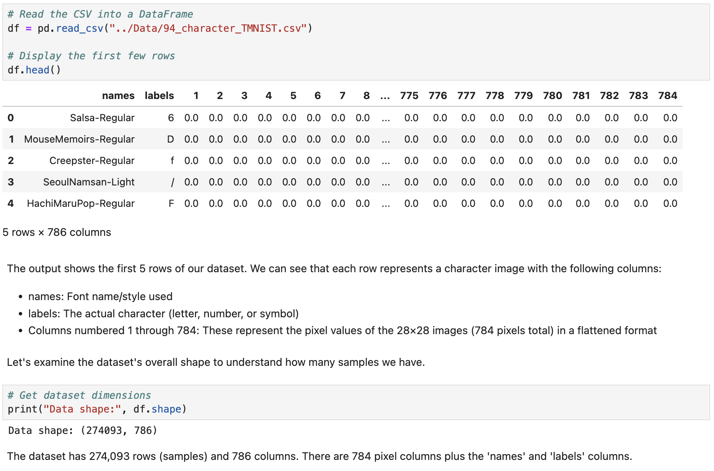
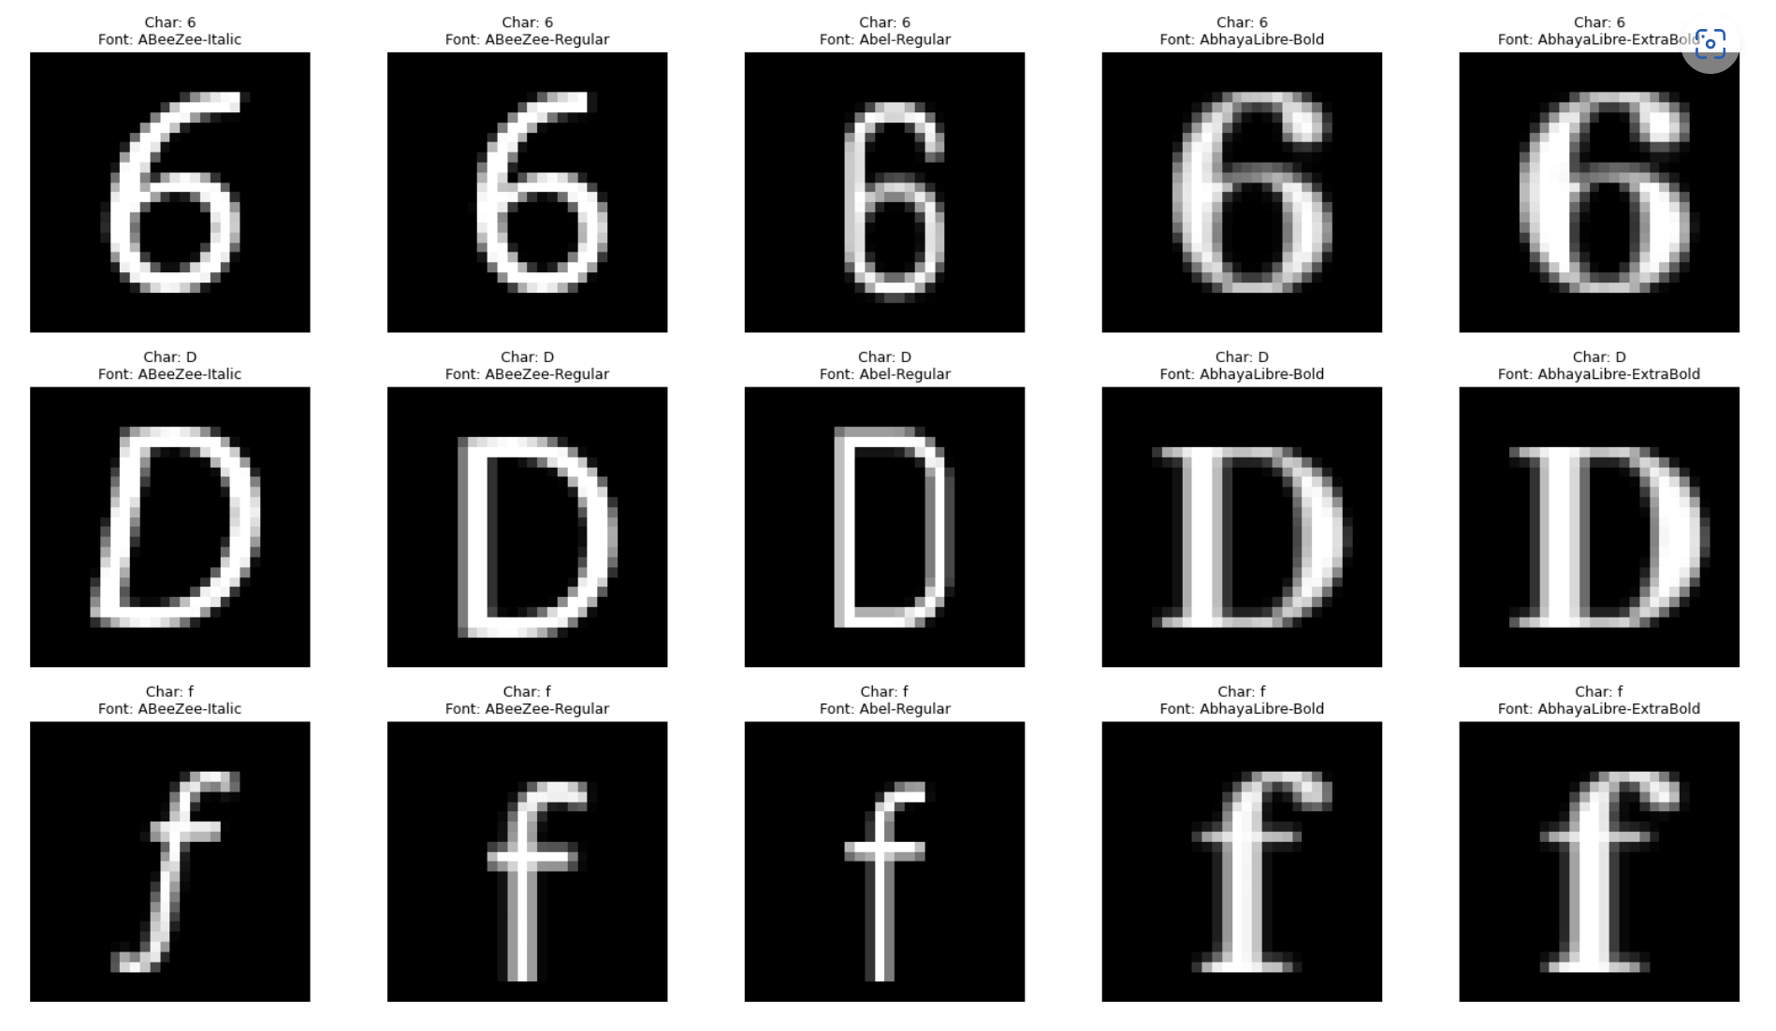
Dataset Description
TMNIST Dataset:
94 unique character classes (letters, digits, symbols)
Variation across multiple font styles
Each row represents an flattened image intensity values and its label
Unbalanced class distribution initially

Slide 4
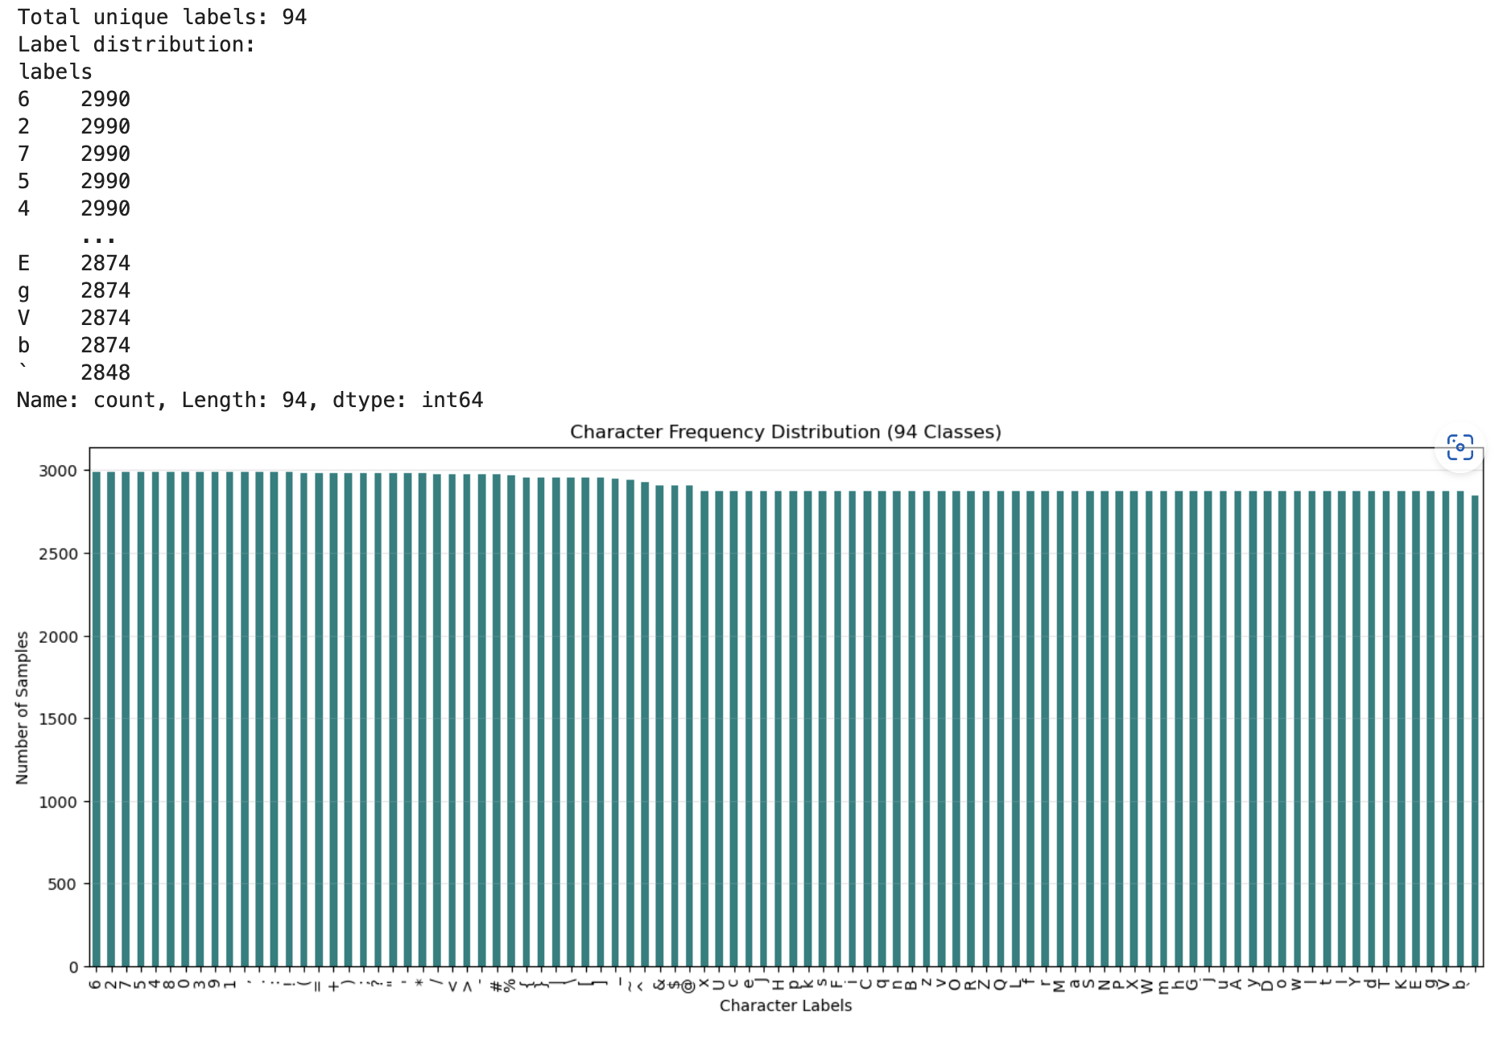
Visualizing Class Imbalance

Slide 5
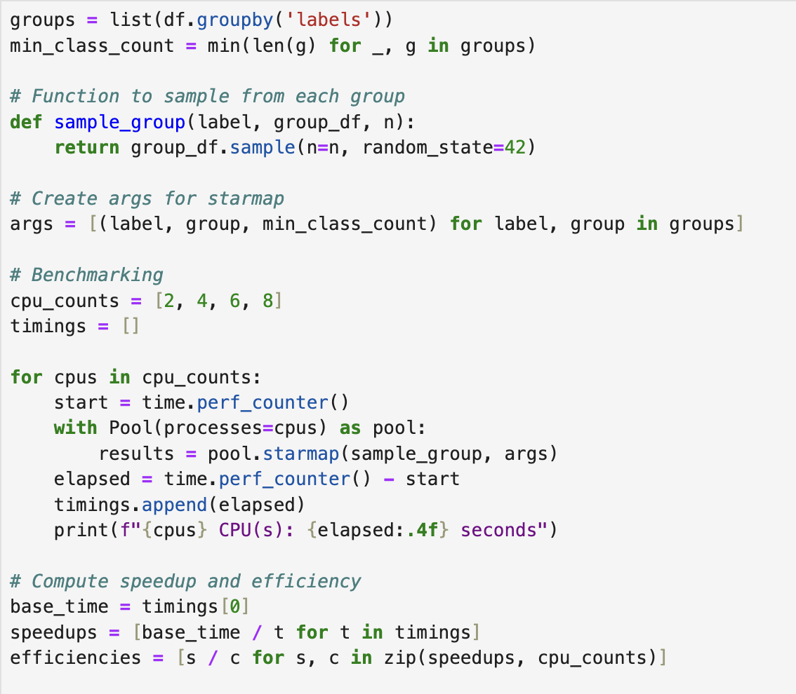
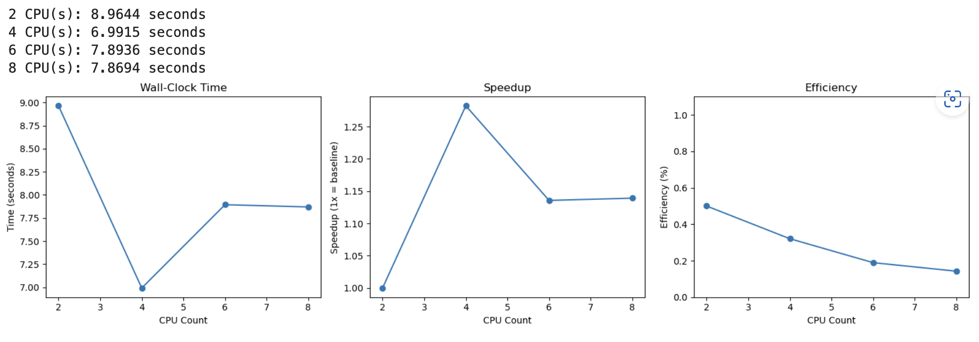
Data Balancing Strategy
Approach:
Select least-N samples per class
Ensure uniform representation
Use multiprocessing (Pool) for parallel processing
Why Parallelism?
Speeds up data transformation
Efficient handling of large datasets

Slide 6
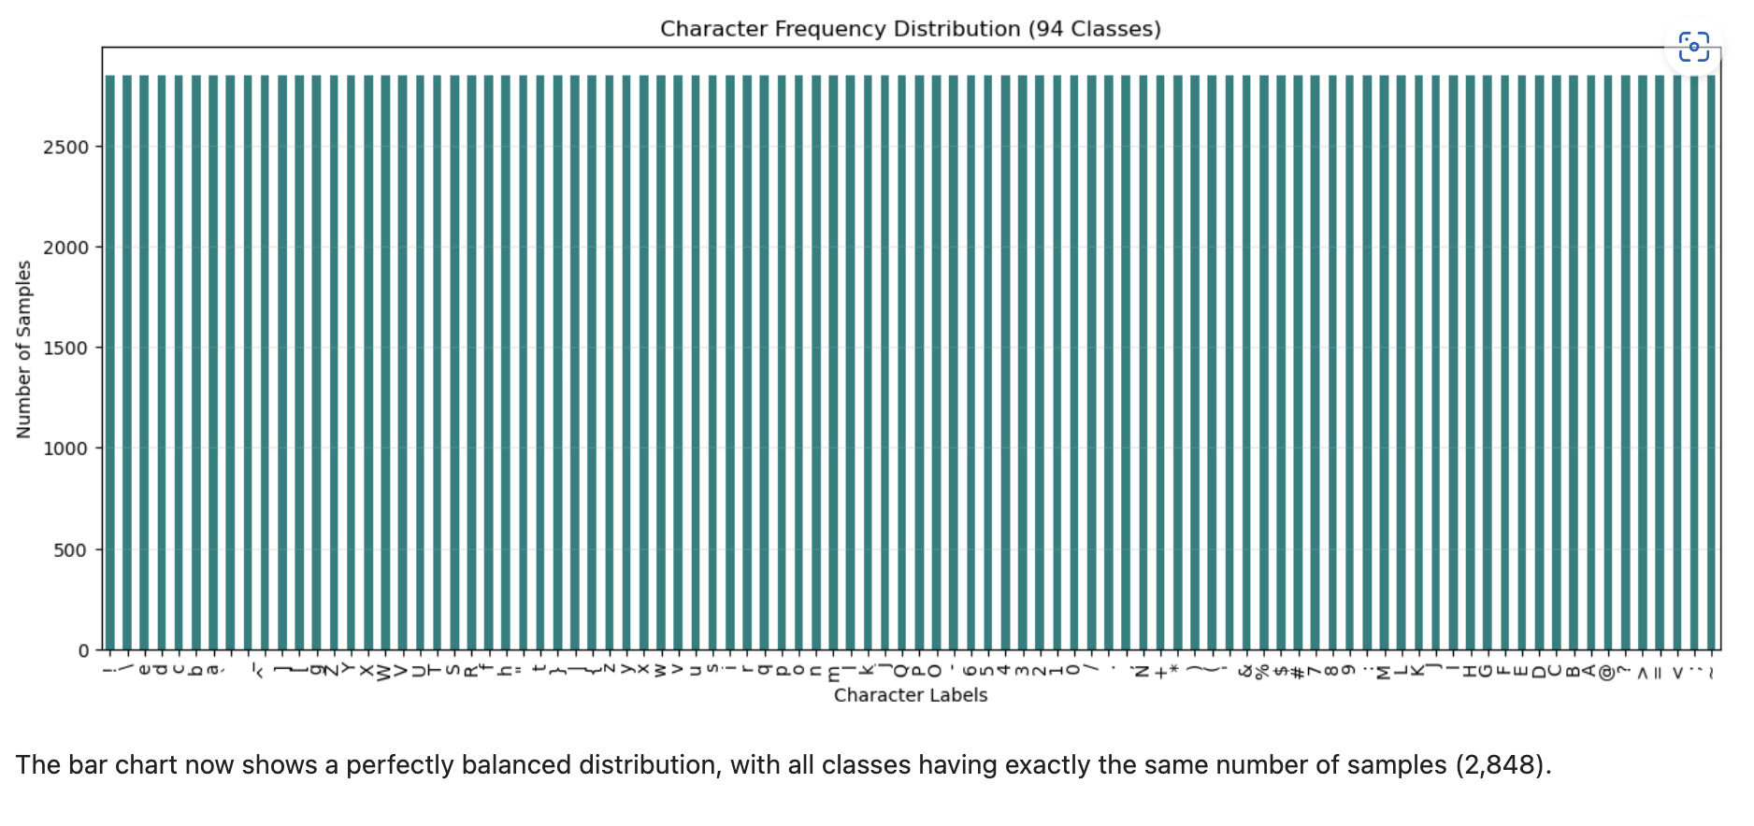
Balanced DataFrame
Our balanced dataset contains 267,712 samples (94 classes × 2,848 samples per class = 267,712 total samples). Each character class now has exactly 2,848 samples, which is determined by the class that had the fewest samples in the original dataset.
shape: (267712, 786)

Slide 7
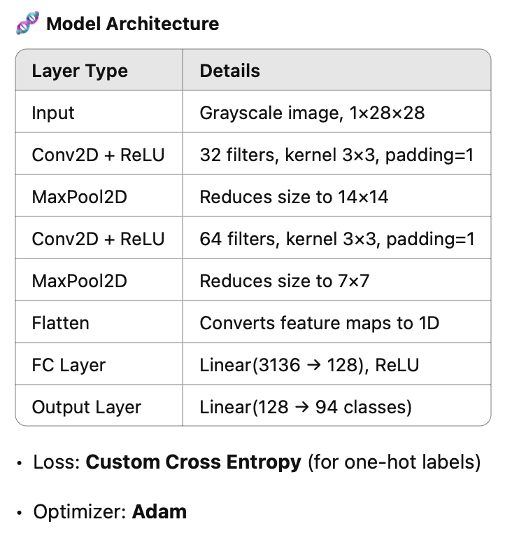
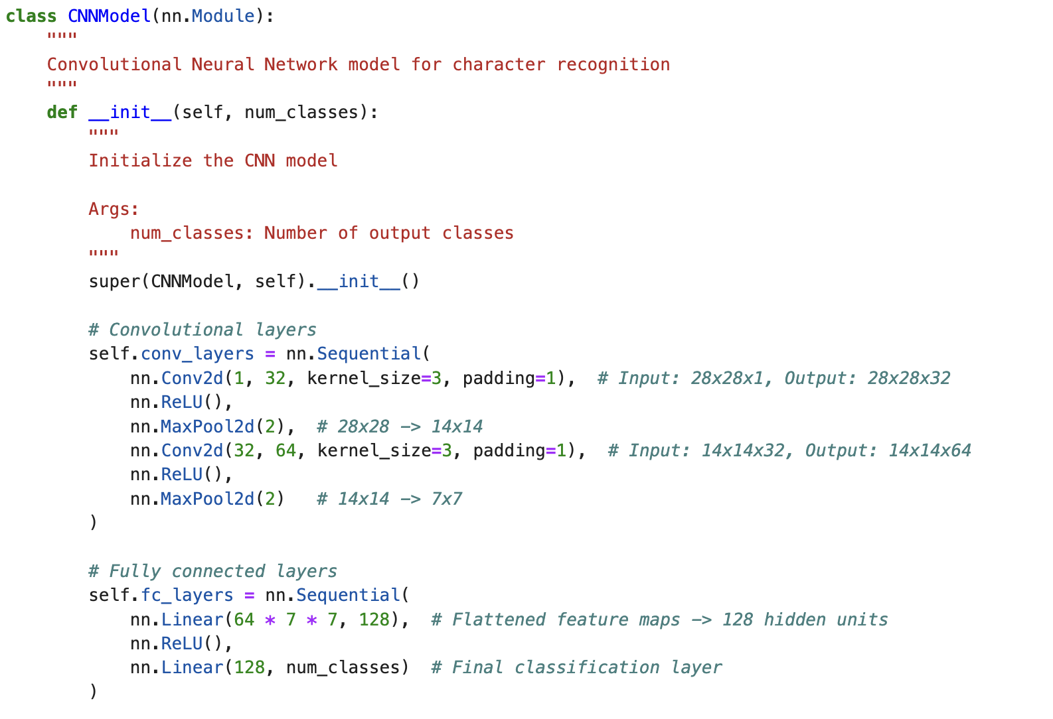
Multi-GPU DDP CNN Model

Slide 8
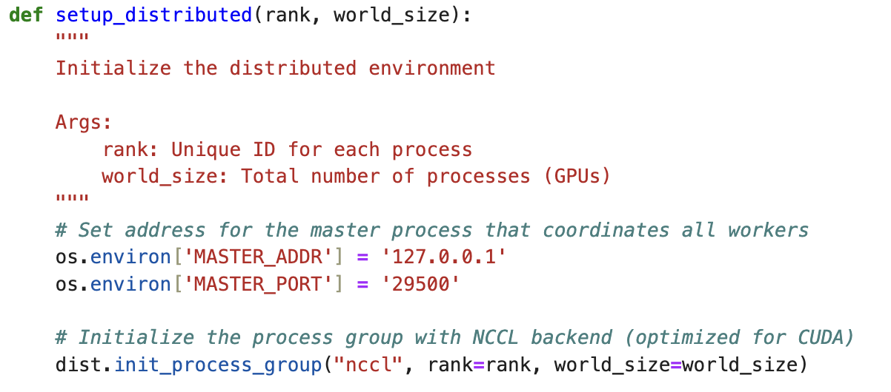
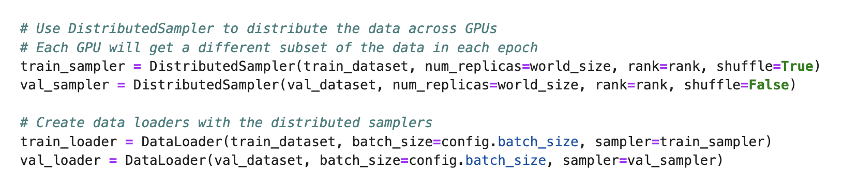
Training with PyTorch DDP
DDP Features in This Setup
Backend: NCCL (optimized for CUDA communication)
Process-per-GPU: Uses mp.spawn() for parallelism
Each GPU trains on a unique data shard via DistributedSampler
batch_sizes = [64, 128, 256, 512, 1024, 2048]
epochs = 12
gpu_counts = list(range(1, available_gpus + 1))
Metrics Logged Per Epoch
Loss / Accuracy (Train & Validation)
Epoch Time and Training Throughput
GPU Utilization (%) and Memory Usage (%)

Slide 9
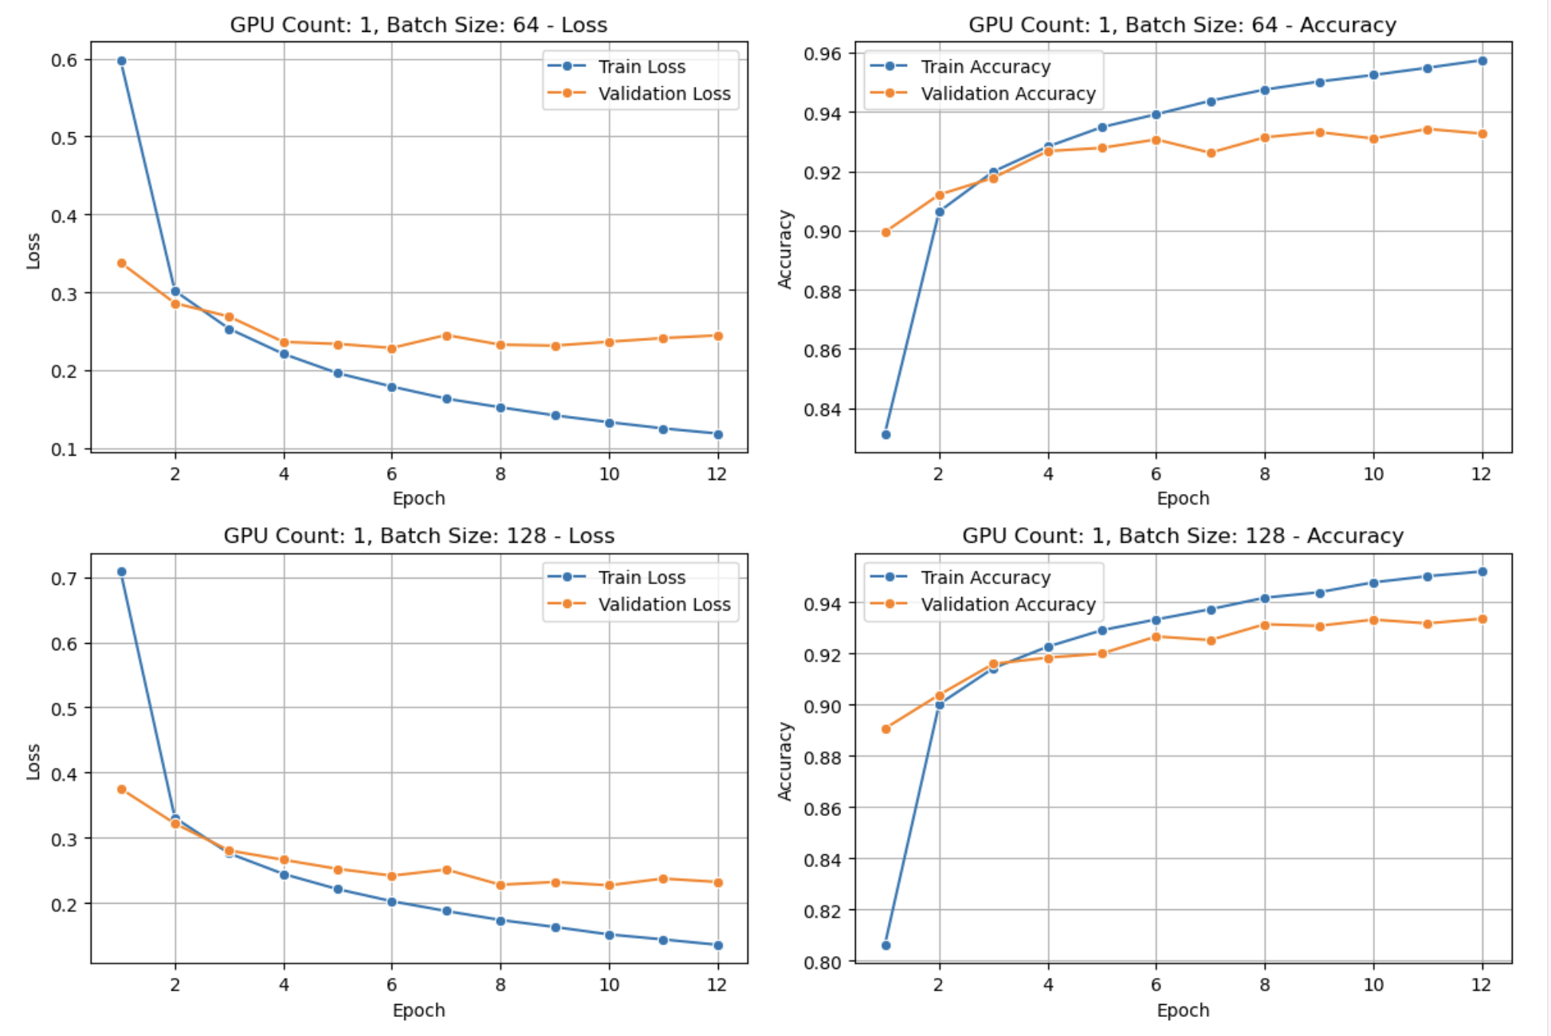
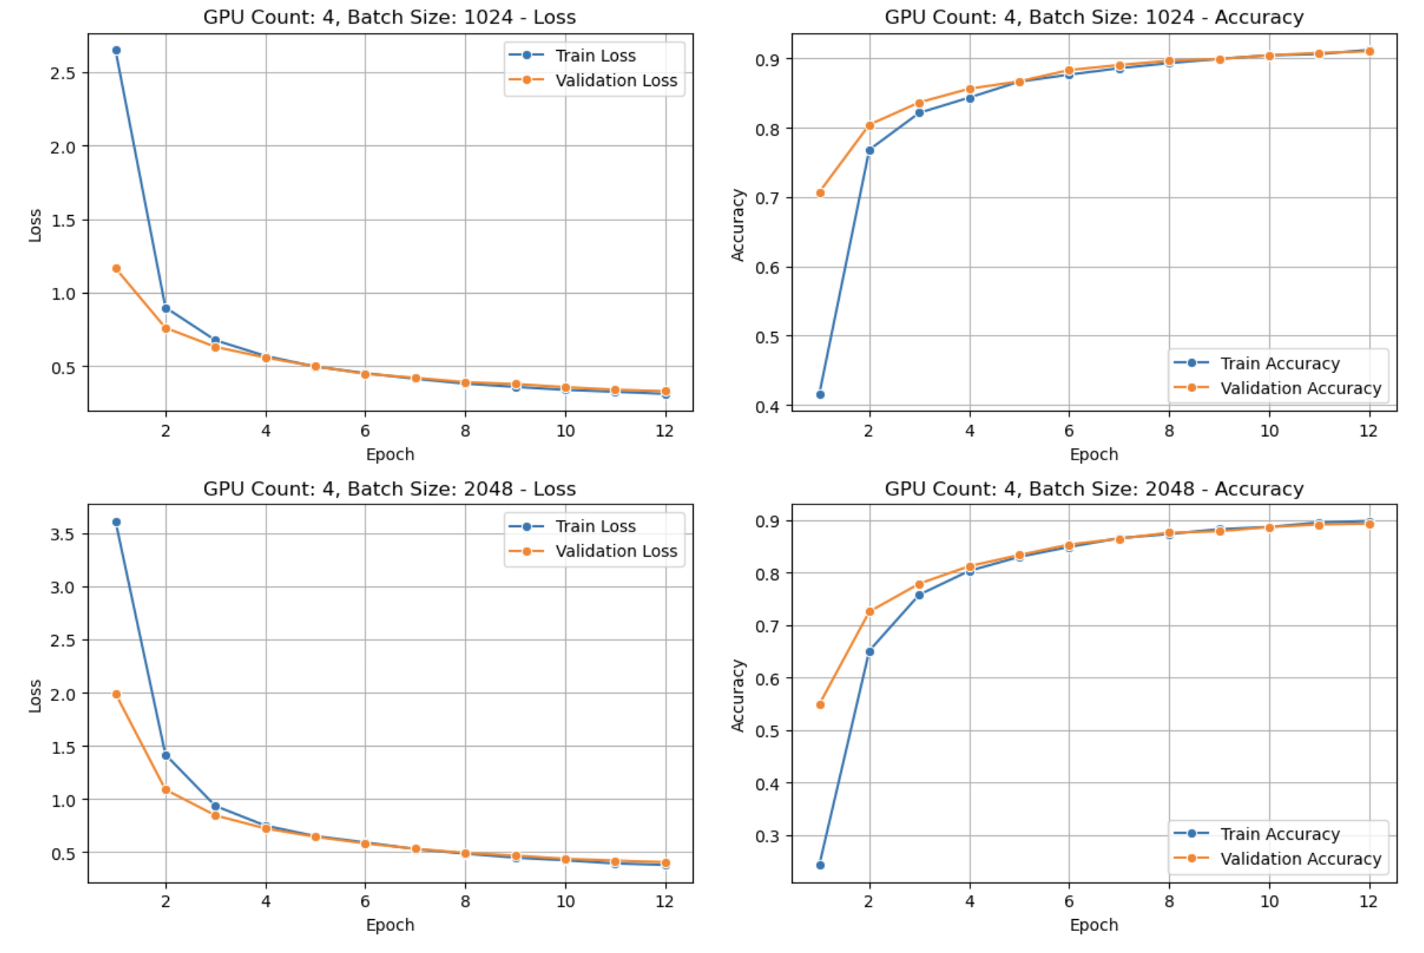
Distributed Data Parallel (DDP) Training Analysis
Learning Curves by GPU Count and Batch Size
(Note: Plots for all set of configurations are available in analysis notebook)

Slide 10
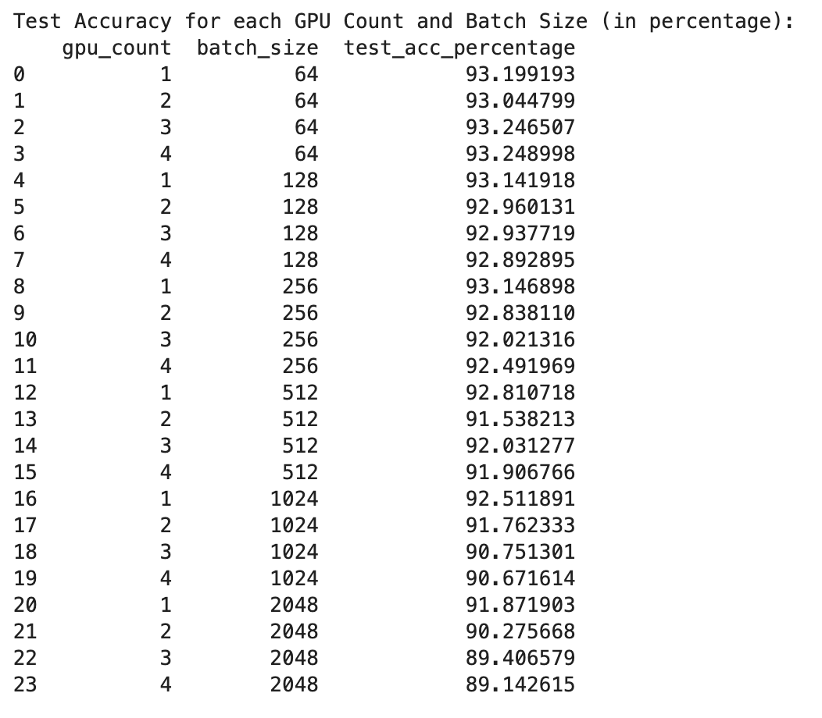
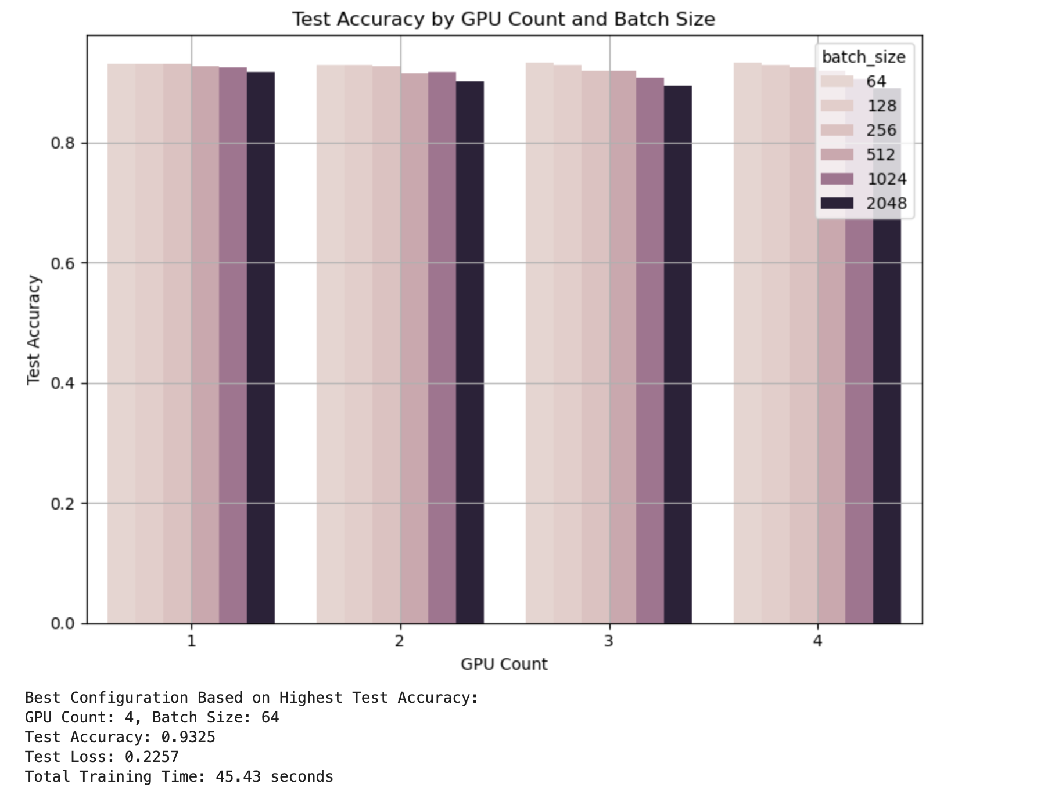
Test Accuracy Across GPU and Batch Size Configurations (DDP)
Notes:
Highest Accuracy: The best test accuracy (93.25%) is achieved with 4 GPUs and batch size 64, though several configurations with smaller batch sizes perform similarly well (around 93%)
Scaling Trends:
There's a clear pattern of declining accuracy as batch size increases, especially with the largest batch sizes
For batch size 2048, accuracy drops significantly from 91.87% with 1 GPU to 89.14% with 4 GPUs

Slide 11
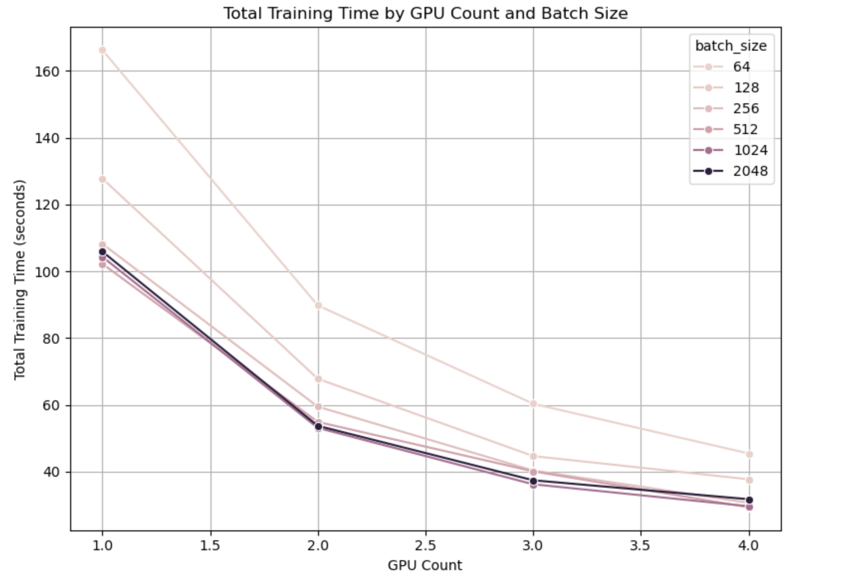
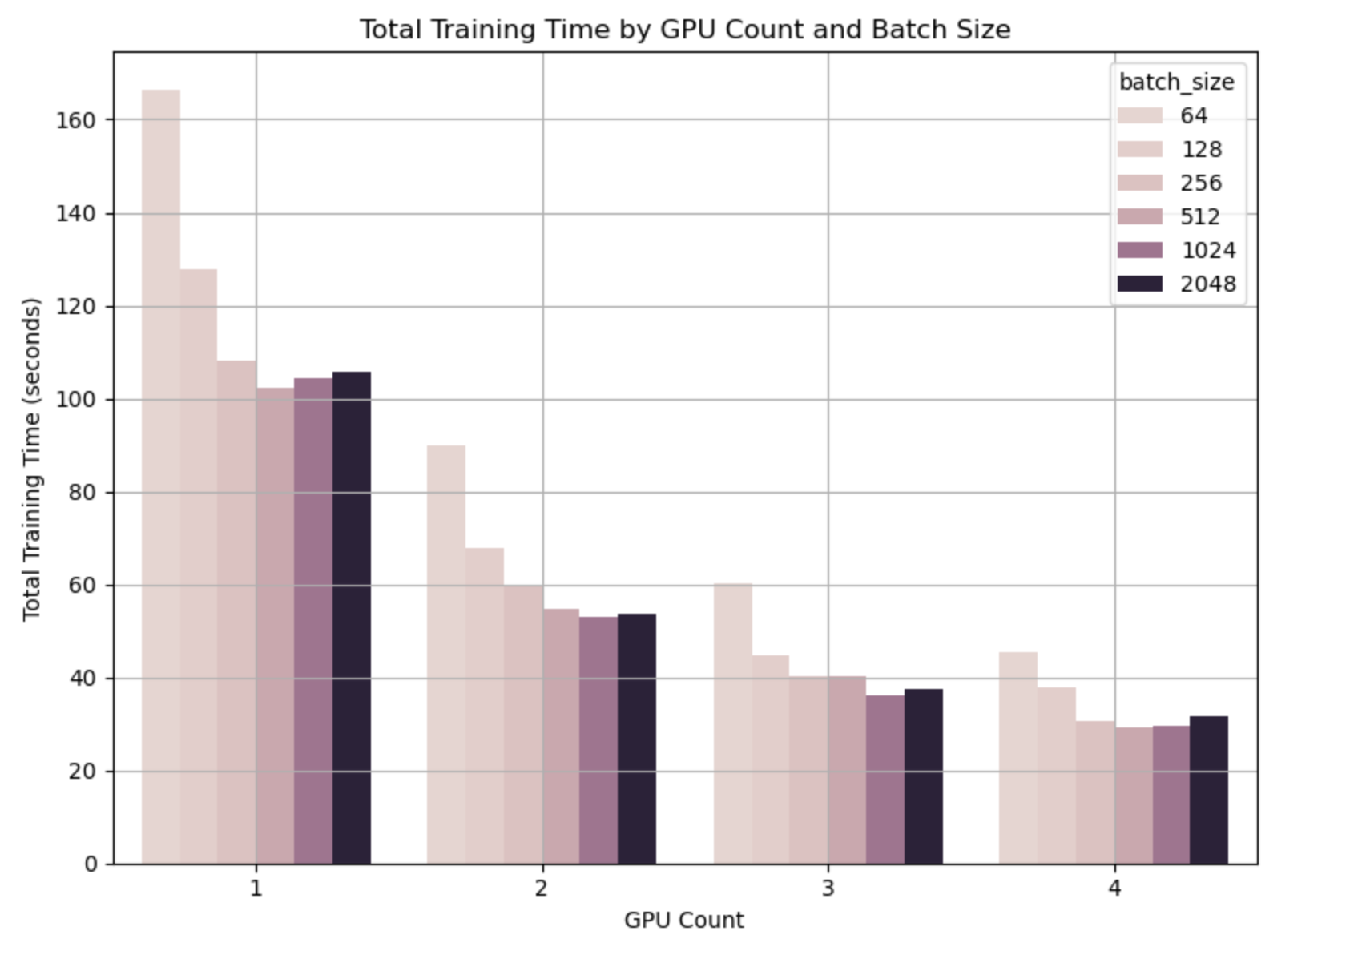
Training Time Scaling with Multiple GPUs (DDP)
Notes:
Scaling Efficiency:
All configurations show significant speedups as we increase GPU count
With batch size 64, training time decreases from ~166 seconds (1 GPU) to 45 seconds (4 GPUs)
This represents a 3.7x speedup using 4x the hardware resources
Diminishing Returns:
The most dramatic time reduction occurs when going from 1 to 2 GPUs
Adding the 3rd and 4th GPU provides progressively smaller improvements
This is typical in distributed systems due to communication overhead
The fastest training configuration is:
GPU Count: 4, Batch Size: 512 - Using maximum parallelism with a moderate batch size
Total Training Time: 29.32 seconds - Approximately 5.7× faster than the single-GPU baseline (166.22s)
Test Accuracy: 91.91% - Still maintains good model performance

Slide 12
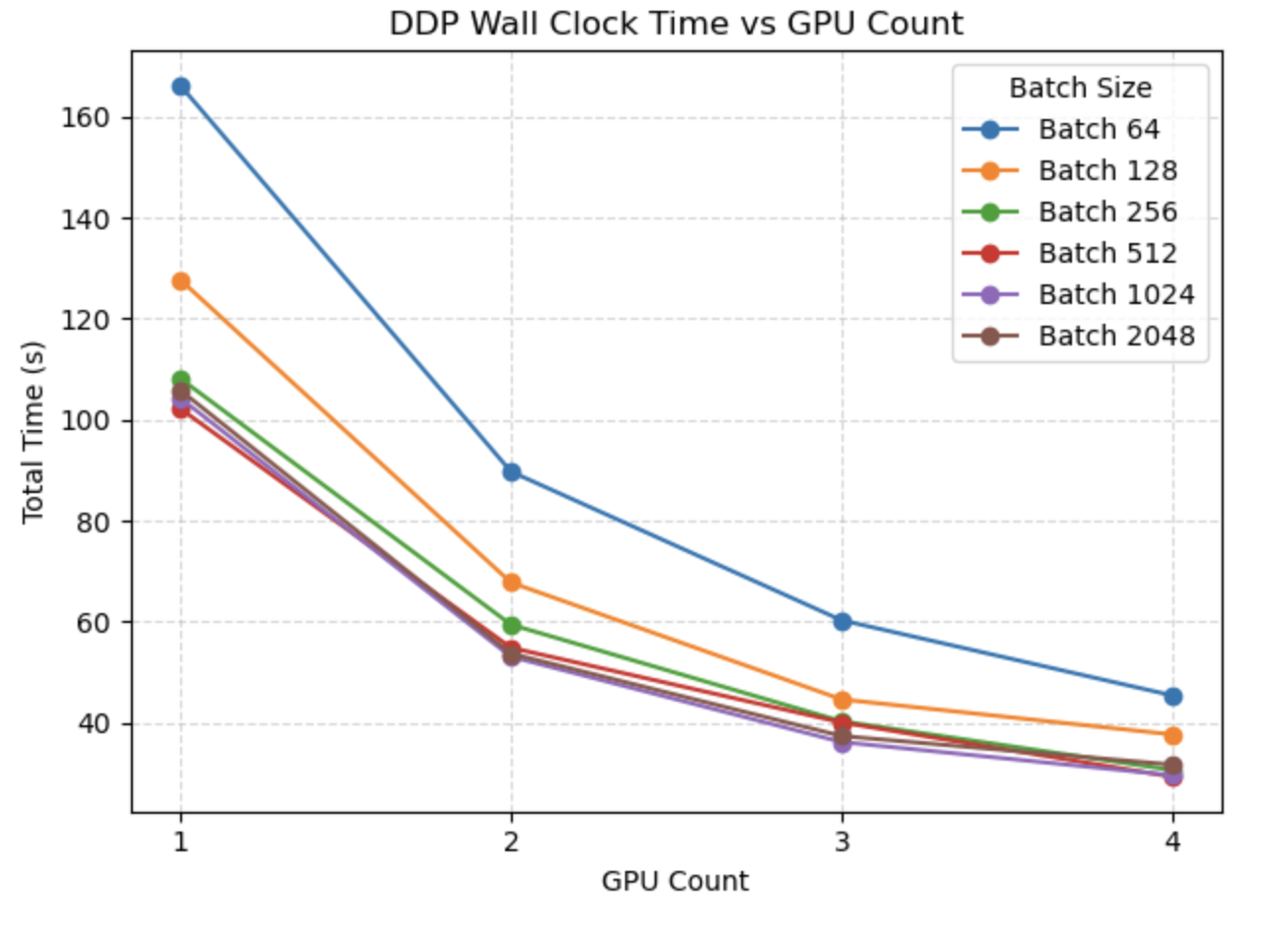
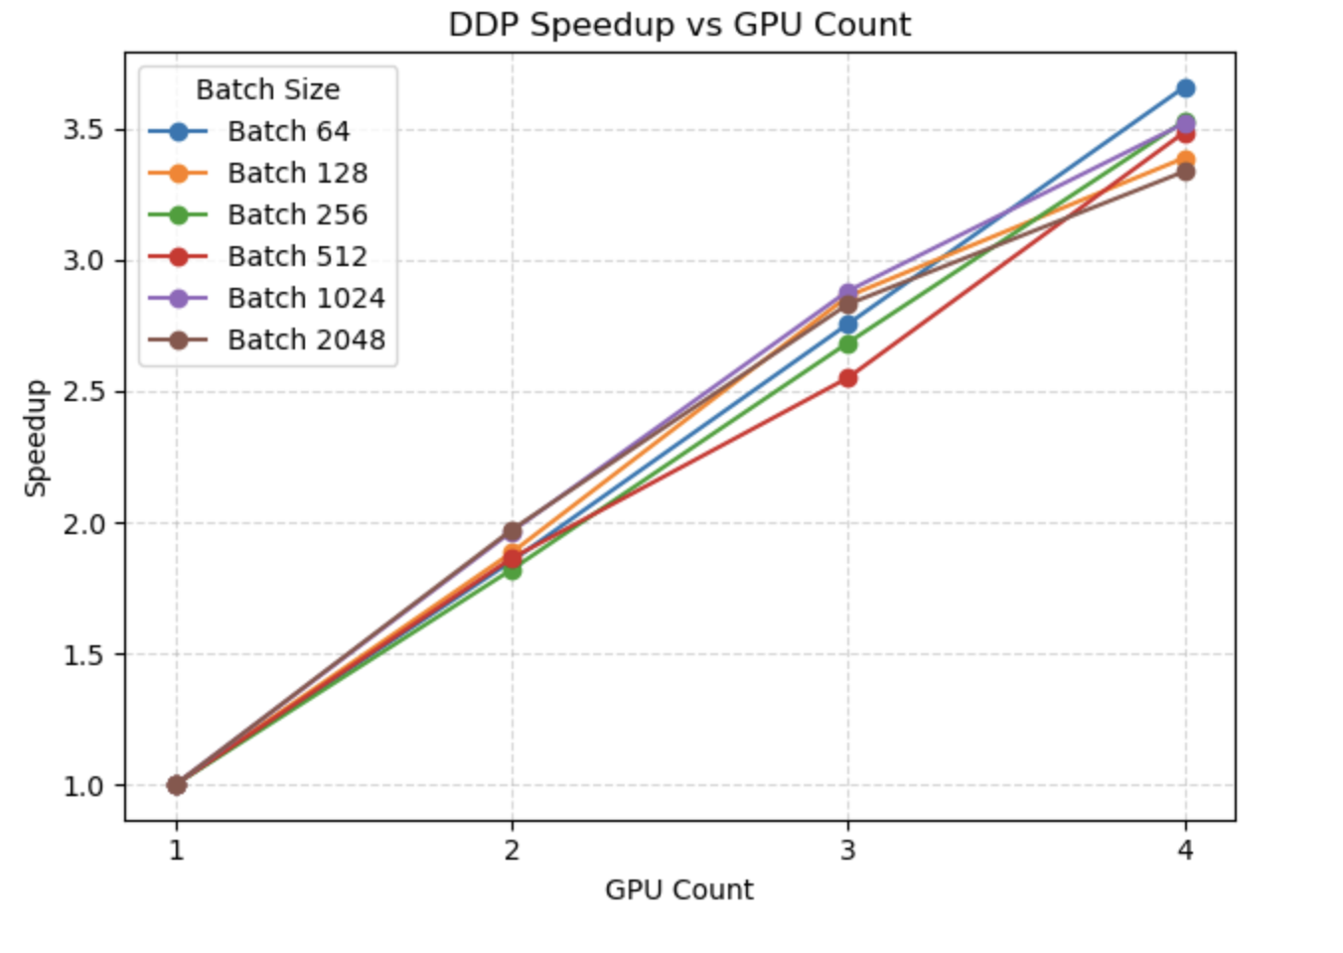
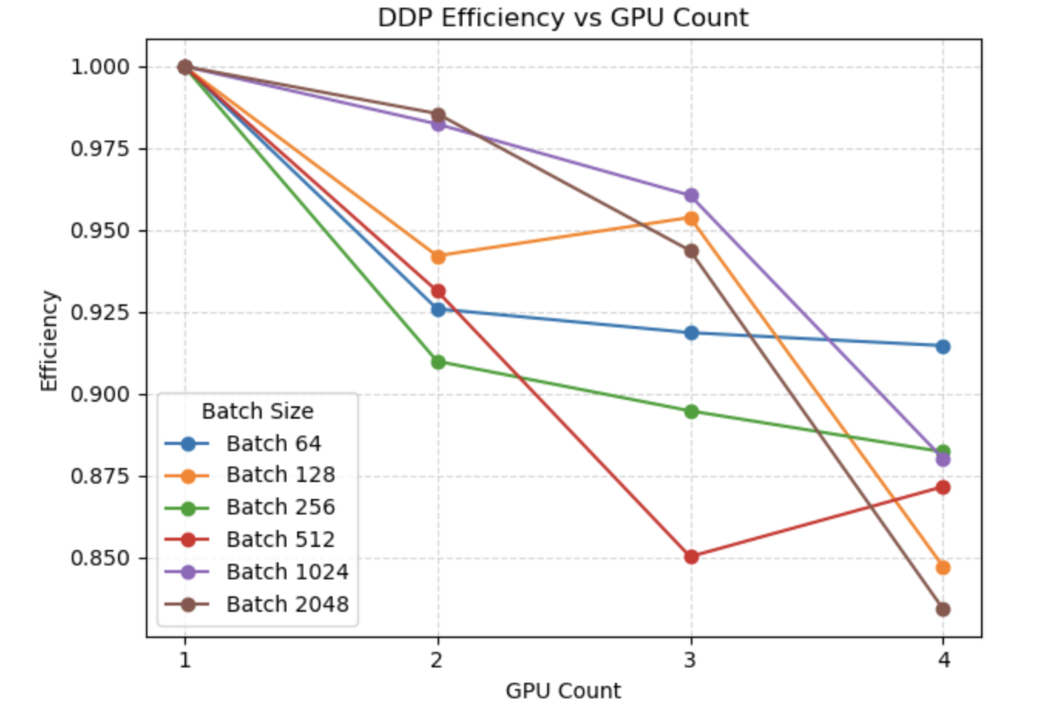
Distributed Training Performance Metrics (DDP)
Based on all metrics:
Best Overall Configuration: 4 GPUs with batch size 64 offers optimal balance of speed (3.66× speedup) while maintaining high parallel efficiency (91.5%) and the best accuracy (93.25%)
Notes:
Wall Clock Time Analysis
The first plot shows the total training time decreasing as more GPUs are added:
Small Batch Sizes (64, 128): Show the most dramatic absolute time reductions, with batch size 64 dropping from 166s to 45s with 4 GPUs
Larger Batch Sizes: Start with lower training times on a single GPU but still benefit from parallelization
Speedup Analysis
The second plot quantifies the acceleration factor relative to single-GPU training:
Near-Linear Scaling: Most configurations achieve 3.3-3.7× speedup with 4 GPUs (82-92% of theoretical 4× speedup)
Best Scaling: Batch 64 achieves the highest speedup (3.66×) with 4 GPUs
Efficiency Analysis
(speedup/GPU count), showing how effectively each GPU is utilized:
Universal Efficiency Loss: All configurations show some efficiency decline as GPUs increase
Batch Size 64: Maintains the most consistent efficiency (~91.5% with 4 GPUs)
Batch 2048: Shows the largest efficiency drop (down to 83.4% with 4 GPUs)
Unusual Patterns: Some configurations show non-monotonic behavior (e.g., batch 512 dips at 3 GPUs)

Slide 13
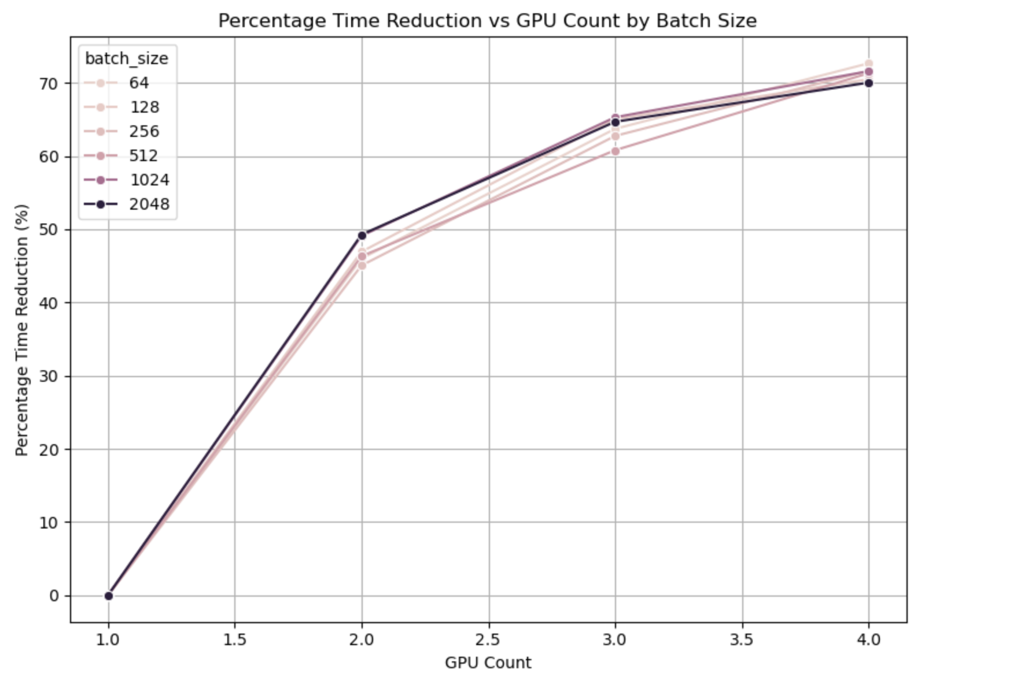
Training Time Reduction (DDP)
Substantial Time Savings:
With 2 GPUs: Training time is reduced by 45-49% across batch sizes
With 3 GPUs: Training time is reduced by 60-65%
With 4 GPUs: Training time is reduced by 70-72%
Notes:
1.Substantial Time Savings:
With 2 GPUs: Training time is reduced by 45-49% across batch sizes
With 3 GPUs: Training time is reduced by 60-65%
With 4 GPUs: Training time is reduced by 70-72%

Slide 14
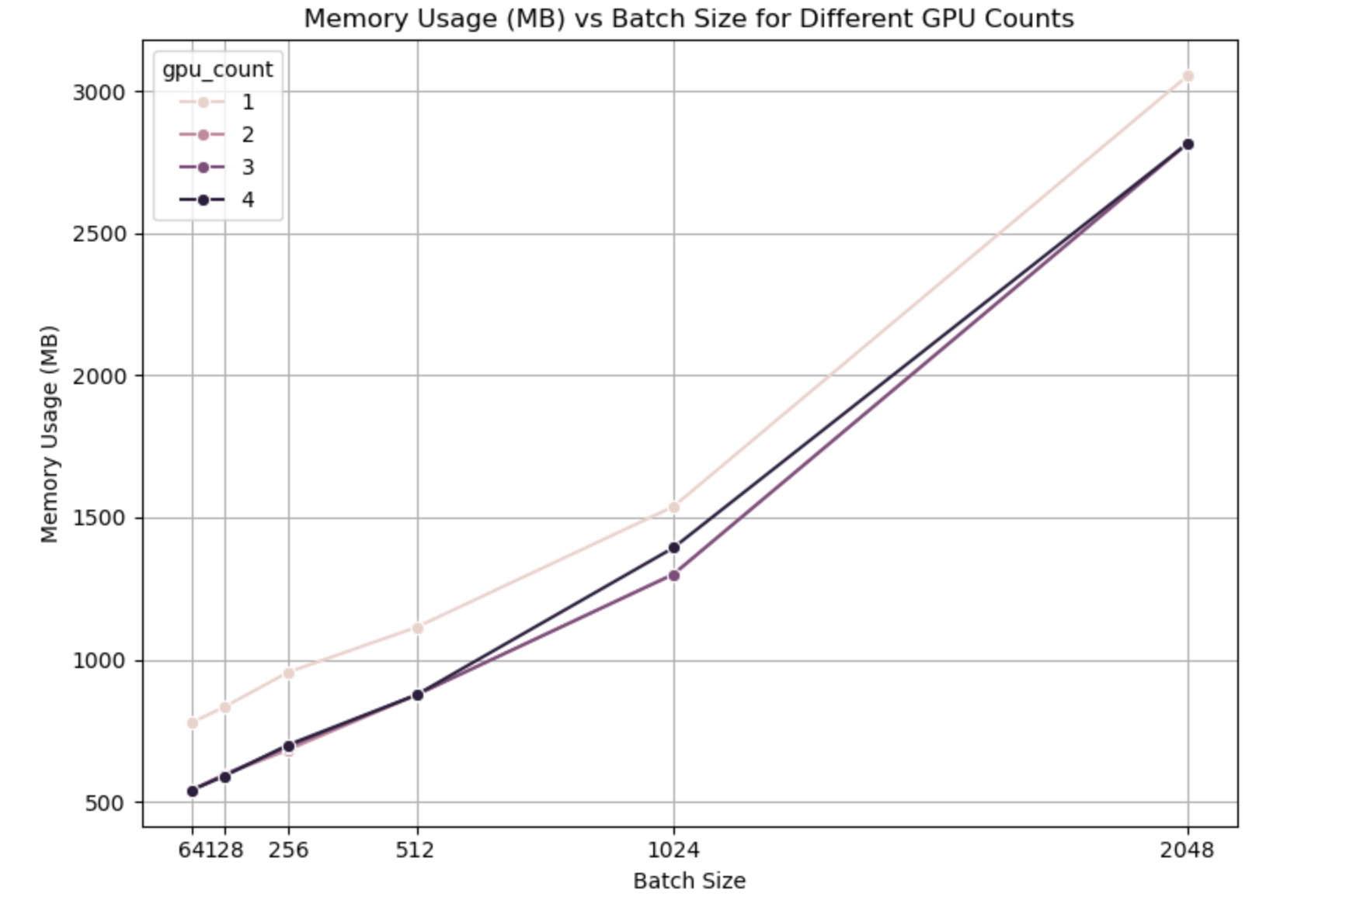
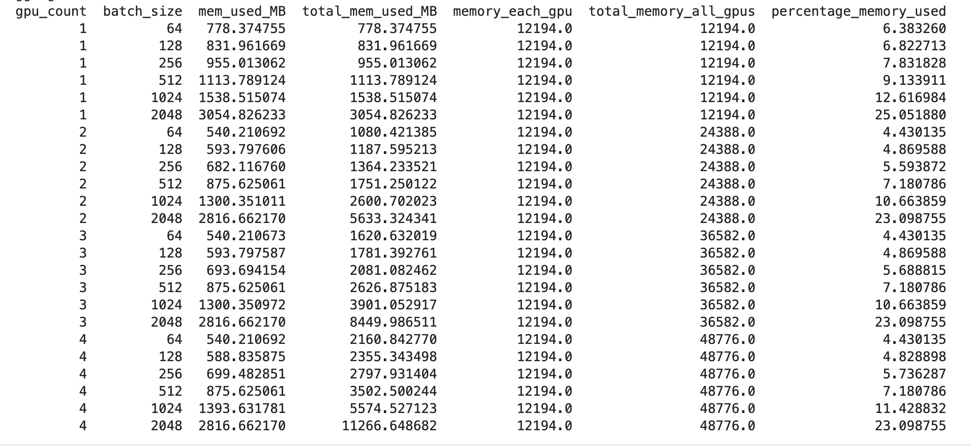
GPU Memory Usage (DDP)
Notes:
Memory Scaling with Batch Size:
Memory usage increases nonlinearly with batch size across all configurations
The steepest increase occurs between batch sizes 1024 and 2048 (almost doubling)

Slide 15
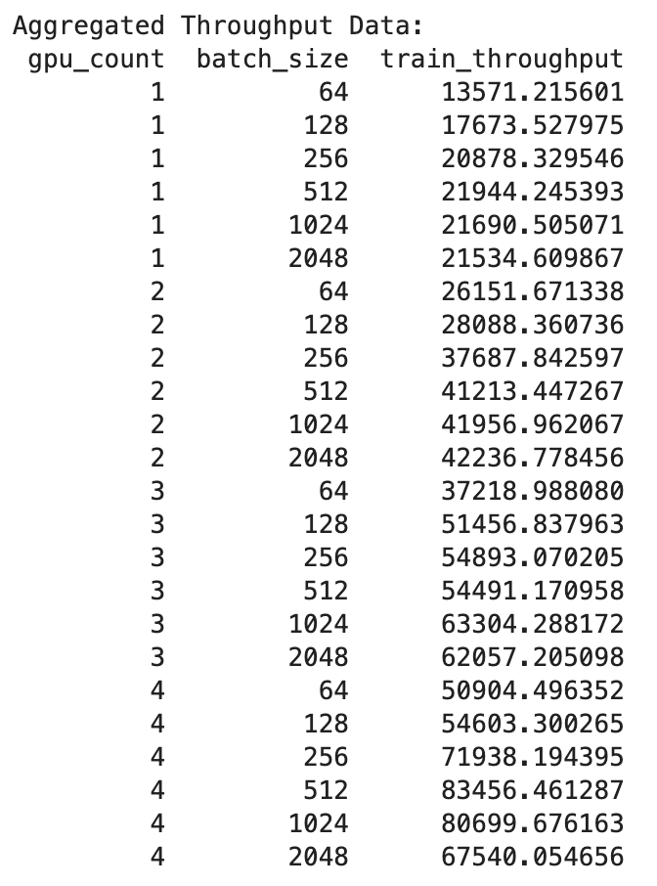
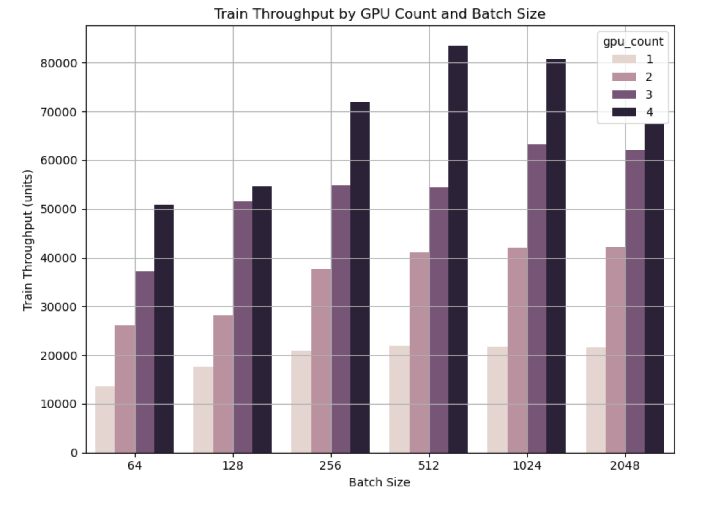
Throughput Analysis in Distributed Training (DDP)
Notes:
GPU Scaling Effects:
For every batch size, throughput increases substantially with more GPUs
With batch size 64: Throughput scales from ~13.5K (1 GPU) to ~50.9K (4 GPUs) - a 3.8× improvement
Optimal Configuration:
The highest throughput (83,456 samples/sec) is achieved with 4 GPUs and batch size 512
This is 3.8× faster than the single GPU peak performance

Slide 16
The Optimal Training Configuration (DDP)
GPU Count: 1, Batch Size: 64 (single GPU with modest batch size)
Best Epoch: 11
Excellent accuracy across all datasets (train: 0.9549, validation: 0.9342, test: 0.9320)
Low loss values (train: 0.1252, validation: 0.2411)
A single GPU with a smaller batch size outperformed configurations with multiple GPUs and larger batches. This demonstrates that distributed training with larger batches doesn't always yield the best model quality, even though it might train faster.
The Best Configuration Based on Highest Test Accuracy and Lowest Total Training Time
Based on this balanced metric, the best configuration is:
GPU Count: 4, Batch Size: 512
Training Time: 29.32 seconds (5.7× faster than single-GPU baseline)
Test Accuracy: 91.91% (only ~1.3% lower than the highest accuracy configuration)

Slide 17
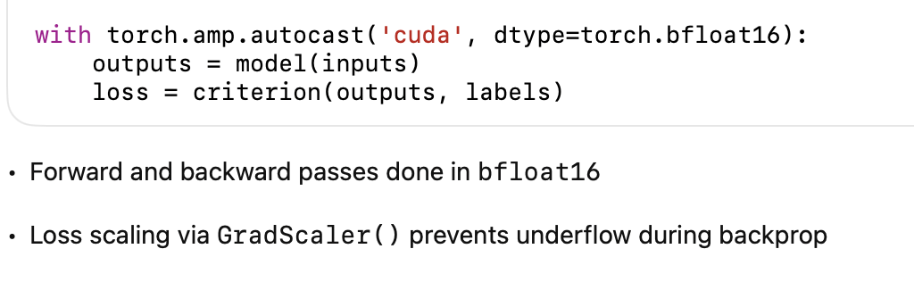
Multi-GPU DDP + AMP(bfloat16)
Why use bfloat16 with AMP?
bfloat16 (Brain Floating Point) has:
Same exponent range as FP32 (good for dynamic range)
Less precision (8 mantissa bits vs 23 in FP32)
Well-suited for H100 GPU: hardware-accelerated support
Benefits Observed
Faster training
Higher GPU throughput and better resource utilization
Maintains accuracy comparable to full-precision training
Notes:
bfloat16 (Brain Floating Point) has:
Same exponent range which is 8 bits as FP32 (good for dynamic range). The benefit of bfloat 16 over regular FP16 is that it avoids the conversion time of exponent to 5bits in case of FP16
Less precision (8 mantissa bits vs 23 in FP32)
Well-suited for H100 GPU: hardware-accelerated support
Benefits Observed
Faster training
Higher GPU throughput and better resource utilization
Maintains accuracy comparable to full-precision training

Slide 18
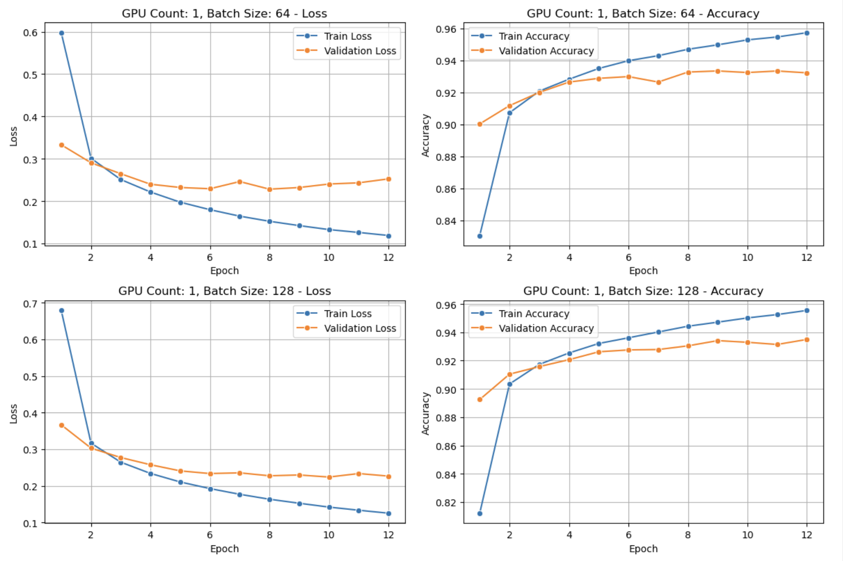
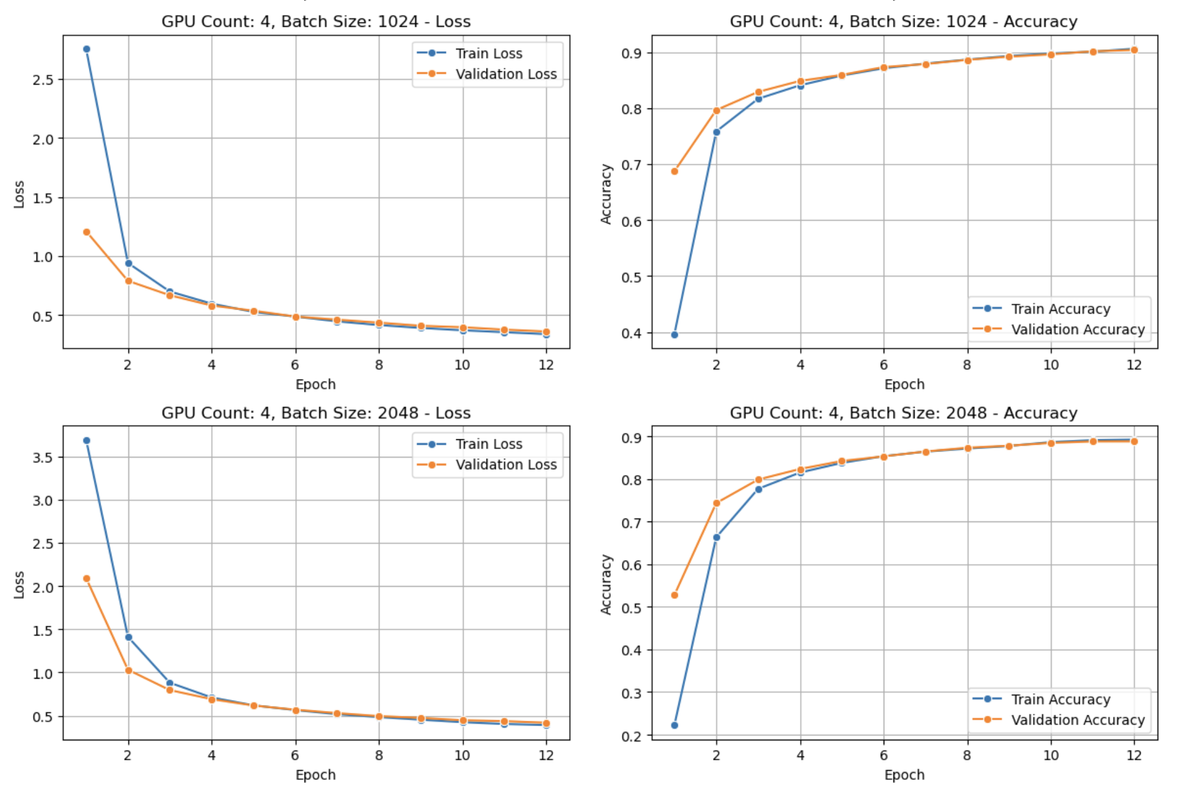
Automic Mixed Precision (AMP) bfloat16 Training Analysis
Learning Curves by GPU Count and Batch Size
(Note: Plots for all set of configurations are available in analysis notebook)

Slide 19
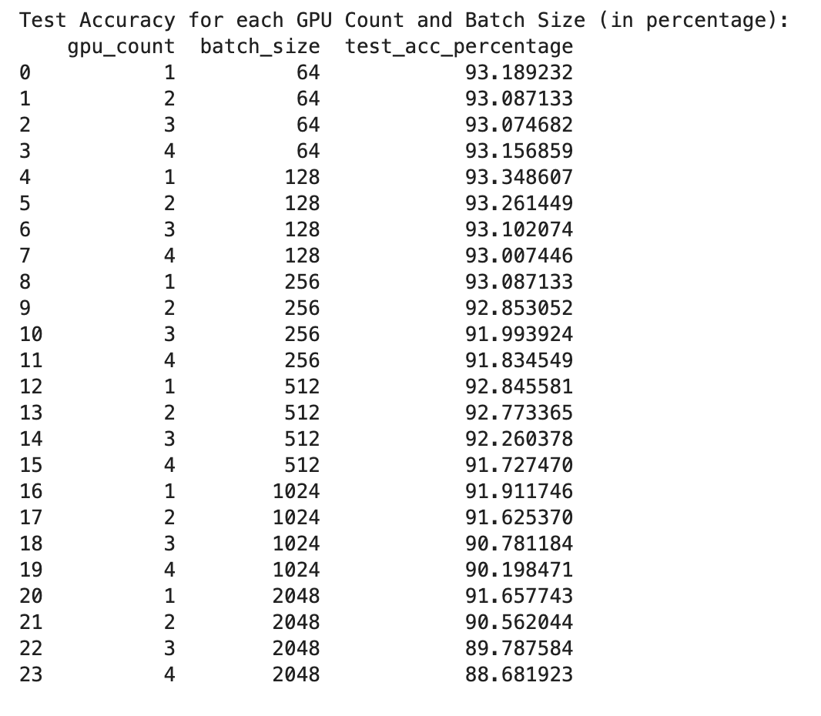
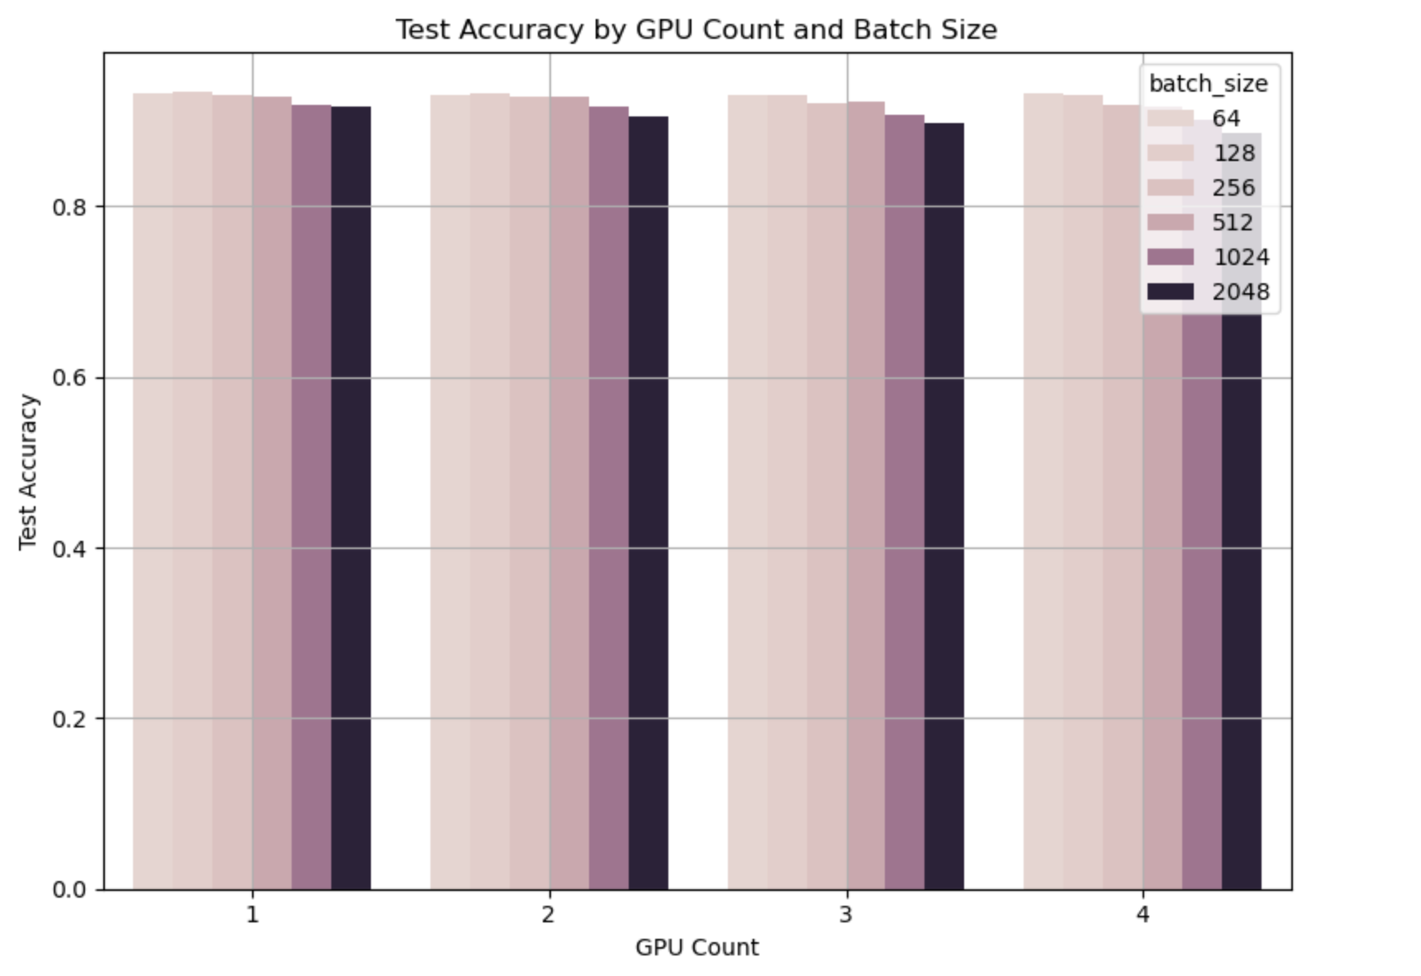
Test Accuracy Across GPU and Batch Size Configurations (DDP + AMP(bfloat16))
Notes:
Batch Size Impact:
Clear inverse relationship between batch size and model accuracy
Small batch sizes (64-128) maintain excellent accuracy (>93%) regardless of GPU count
Largest batch size (2048) shows significant accuracy degradation, dropping below 90% with 3-4 GPUs

Slide 20
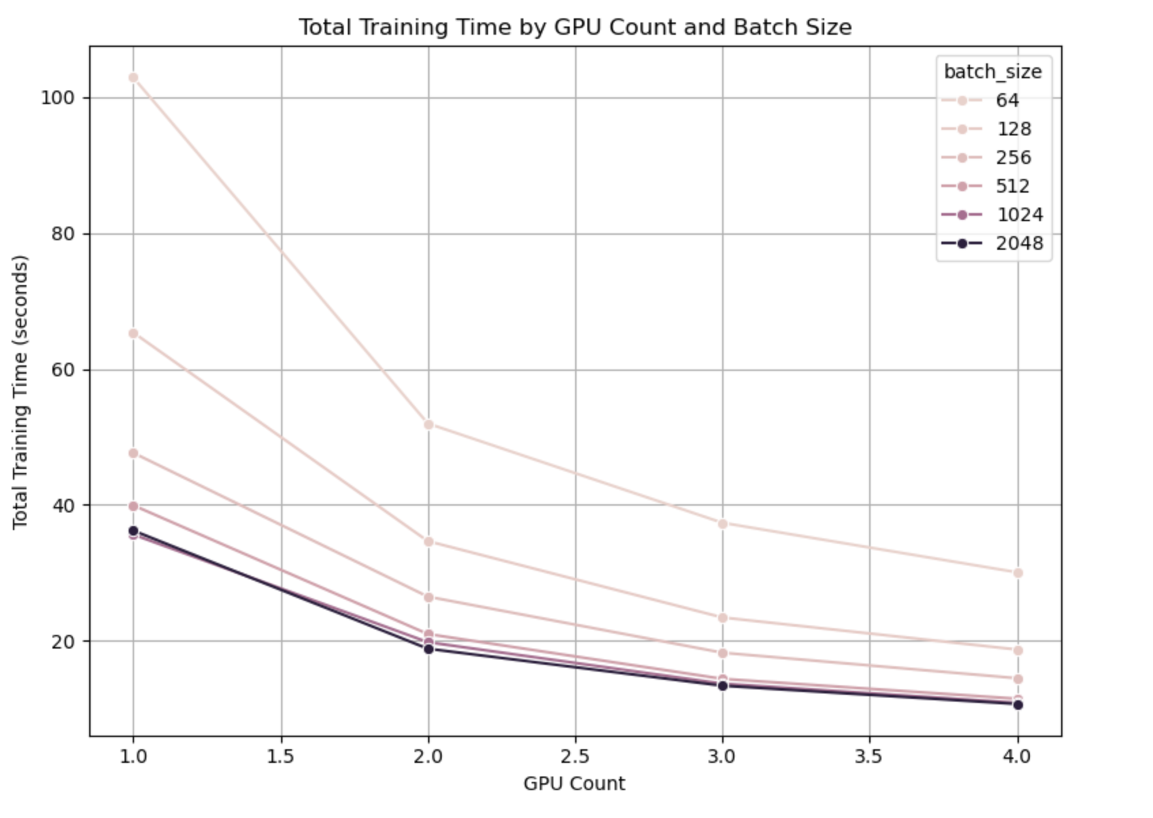
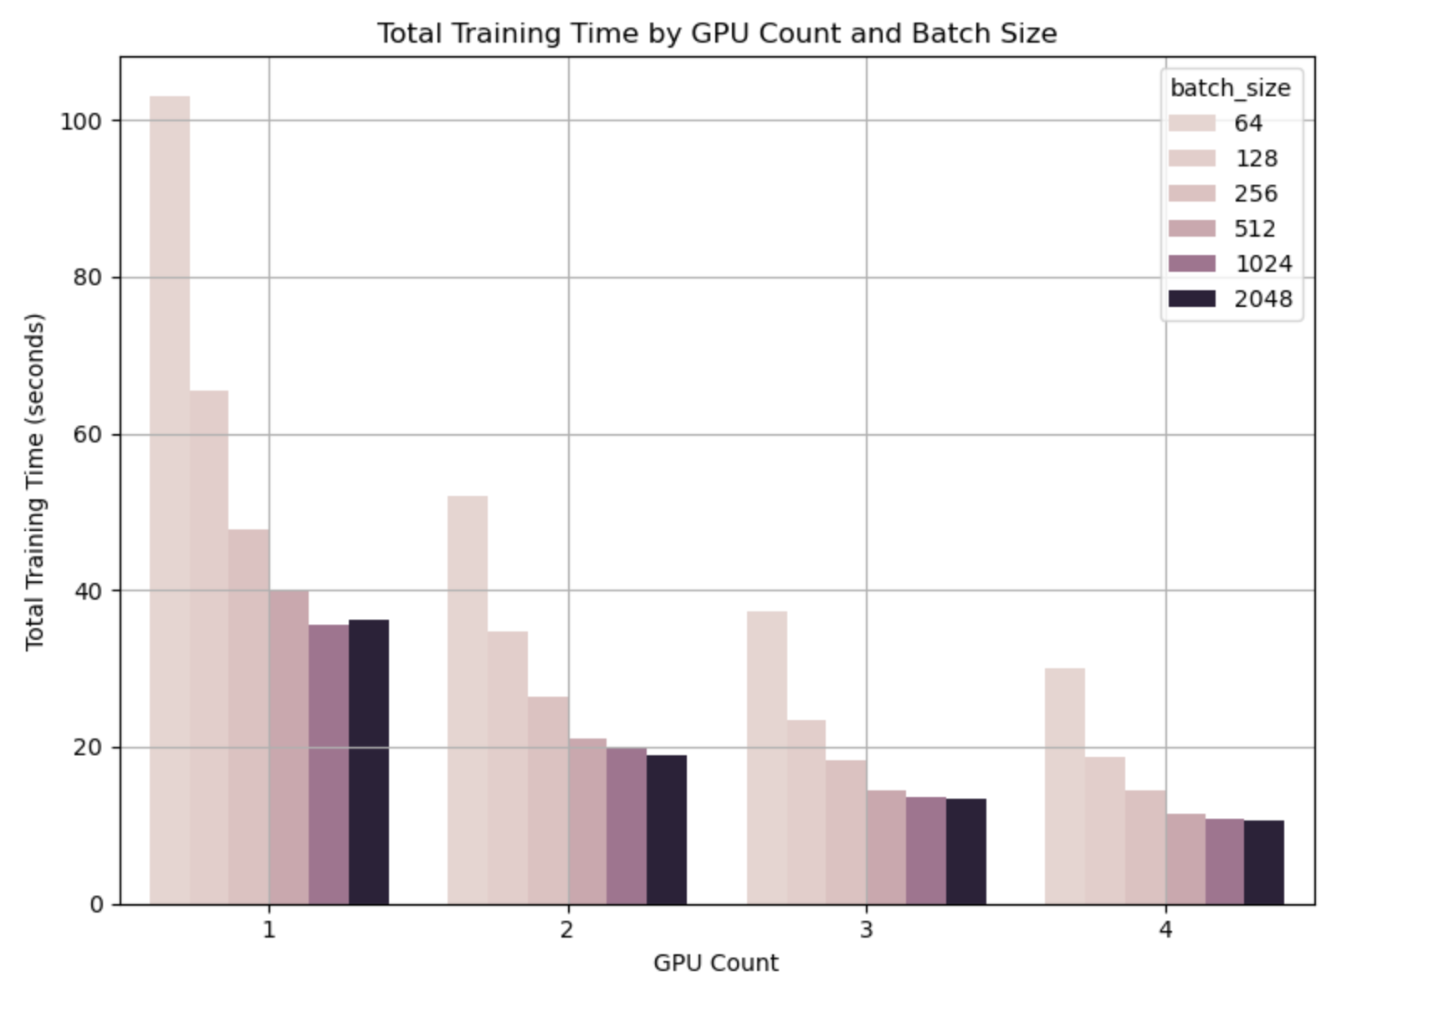
Training Time Scaling with Multiple GPUs (DDP + AMP(bfloat16))
Superior Scaling Behavior
Batch Size Impact
Ultimate Performance
Notes:
Superior Scaling Behavior:
All batch size configurations show substantial training time reductions as GPU count increases
The most significant improvements occur between 1→2 GPUs, with more moderate gains from 3→4 GPUs
Batch size 64 shows the most dramatic reduction, from ~103 seconds (1 GPU) to ~30 seconds (4 GPUs)
Ultimate Performance:
Most configurations with 4 GPUs achieve training times under 20 seconds
The fastest training configuration (4 GPUs, batch size 2048) completes in just ~10.7 seconds
This represents approximately a 9.6× speedup compared to the slowest configuration (1 GPU, batch size 64)

Slide 21
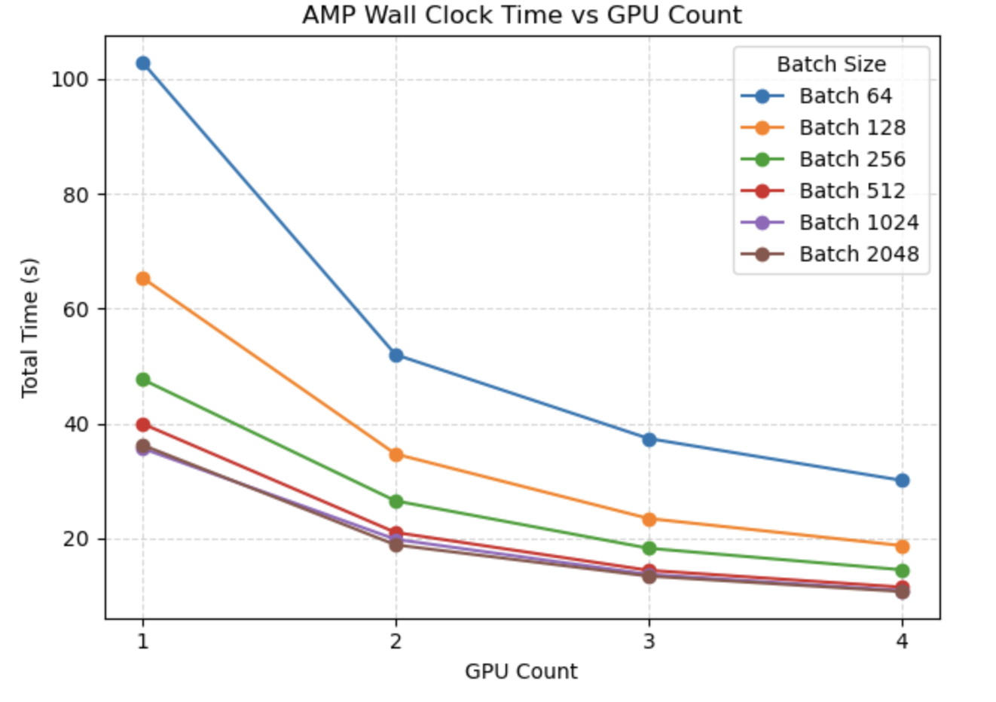
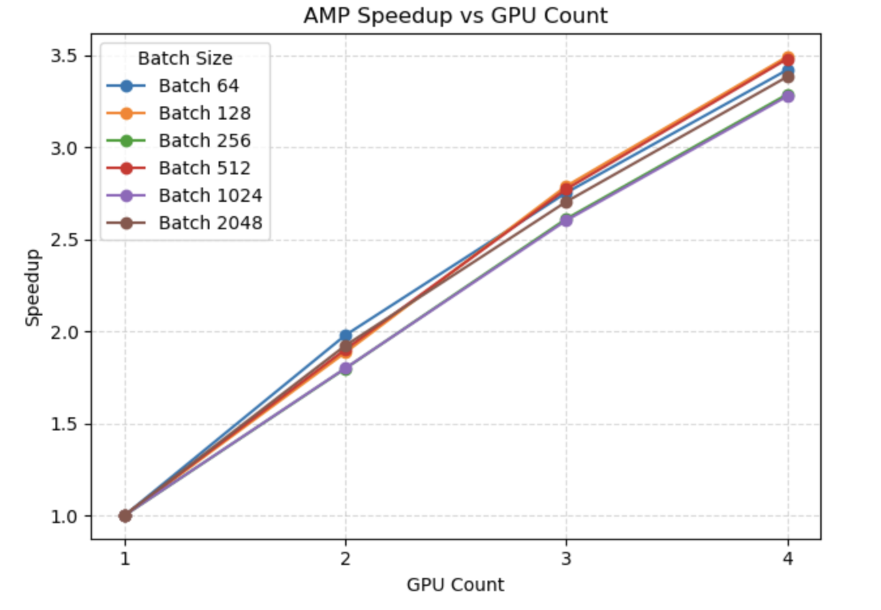
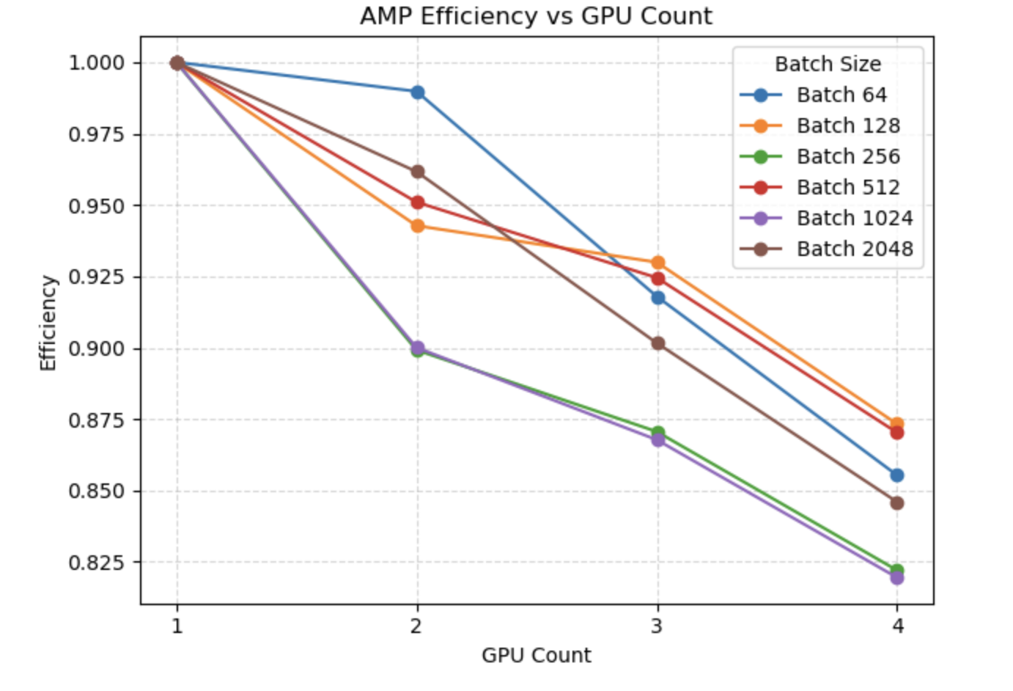
Distributed Training Performance Metrics (DDP + AMP(bfloat16))
Notes:
Wall Clock Time Analysis (First Visualization)
The first plot shows training time decreasing as GPU count increases:
Strong Scaling Pattern: All batch sizes show substantial time reductions with additional GPUs
Batch Size Impact: Smaller batch sizes (64, 128) show the most dramatic absolute time reductions
Speedup Analysis (Second Visualization)
The speedup plot quantifies the acceleration factor relative to single-GPU training:
Near-Linear Scaling: Most configurations achieve 3.2-3.5× speedup with 4 GPUs
Efficiency Analysis (Third Visualization)
The efficiency plot (speedup/GPU count) reveals how effectively each GPU contributes:
Efficiency Decline: All configurations show some efficiency loss as GPUs increase
Batch Size Variation: Medium batch sizes (128, 512) maintain the highest efficiency at 4 GPUs (~87%)
Size-Specific Patterns: Batch size 256 and 1024 show the steepest efficiency drops (down to 82%)

Slide 22
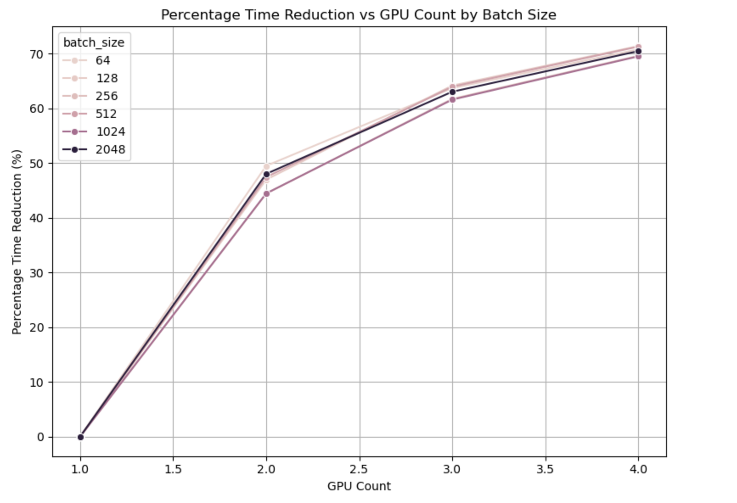
Training Time Reduction Analysis (DDP + AMP(bfloat16))
Substantial Improvements:
With 2 GPUs: Training time is reduced by 44-49% across batch sizes
With 3 GPUs: Training time is reduced by 61-64%
With 4 GPUs: Training time is reduced by 69-71%
Notes:
Substantial Improvements:
With 2 GPUs: Training time is reduced by 44-49% across batch sizes
With 3 GPUs: Training time is reduced by 61-64%
With 4 GPUs: Training time is reduced by 69-71%
Diminishing Returns Pattern:
The steepest reduction occurs between 1→2 GPUs (44-49%)
Adding the 3rd GPU provides an additional 14-17% reduction
Adding the 4th GPU yields a more modest 7-9% additional reduction

Slide 23
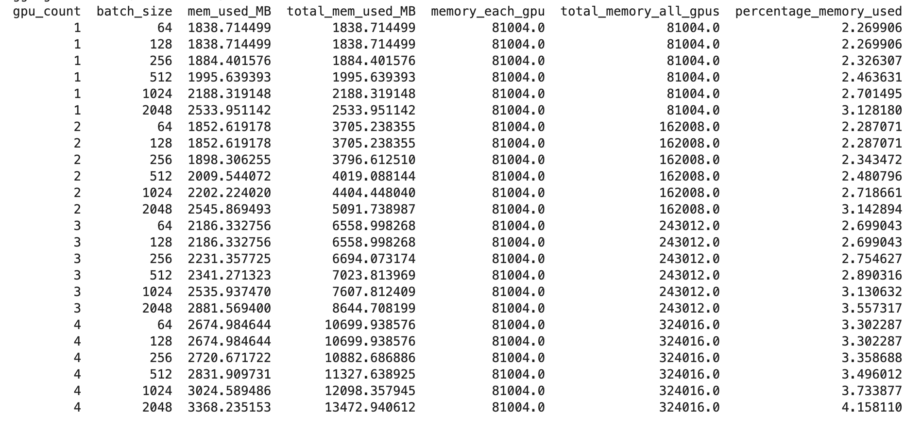
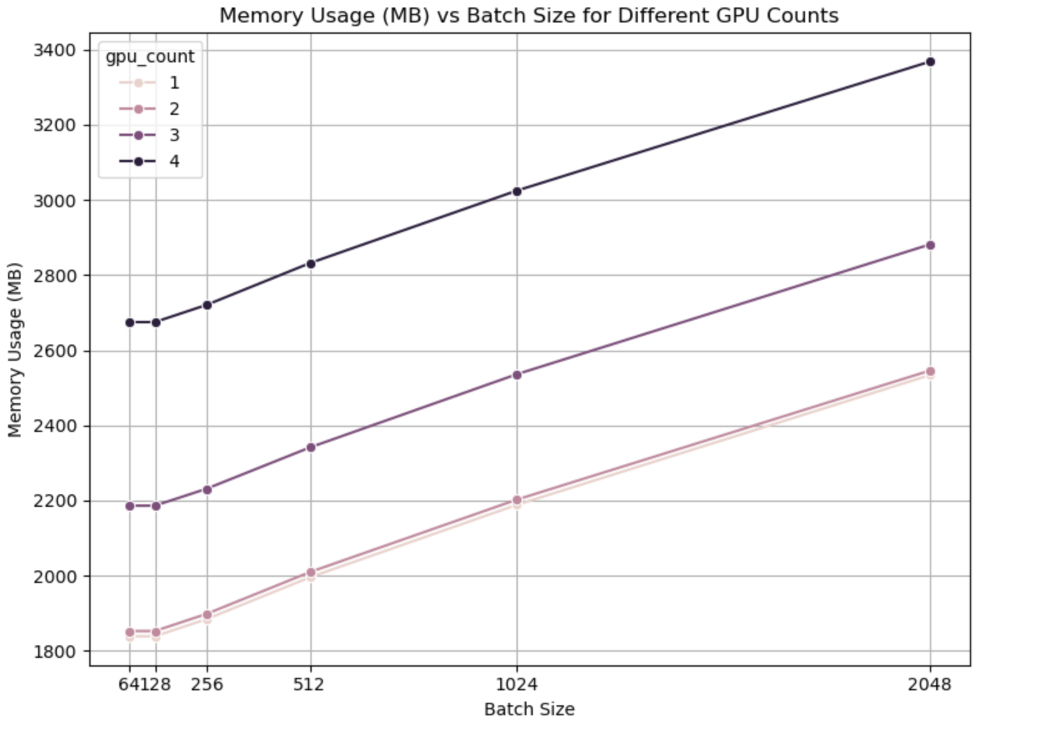
GPU Memory Usage (DDP + AMP(bfloat16))
Batch Size Impact
GPU Count Effect
Configuration-Specific Patterns
Notes:
Batch Size Impact:
Memory usage increases with batch size across all GPU configurations
The relationship is nearly linear for larger batch sizes (512-2048)
For small batch sizes (64-128), memory usage remains relatively constant
From batch size 64 to 2048: Memory increases by ~38% with 1 GPU and by ~26% with 4 GPUs

Slide 24
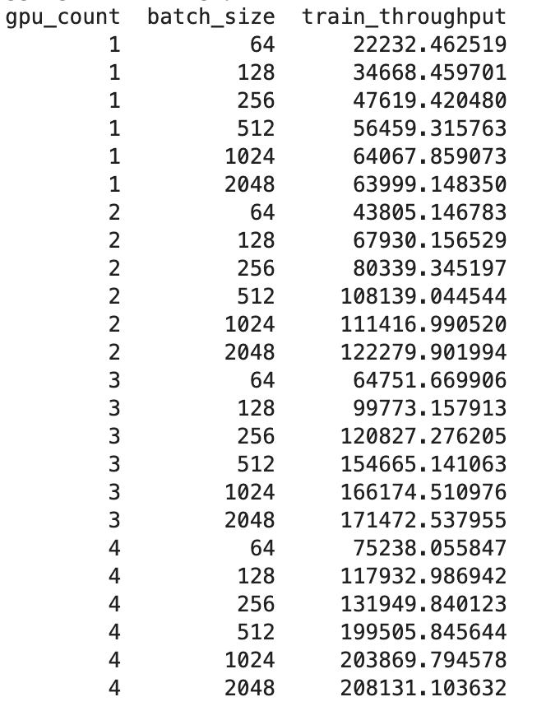
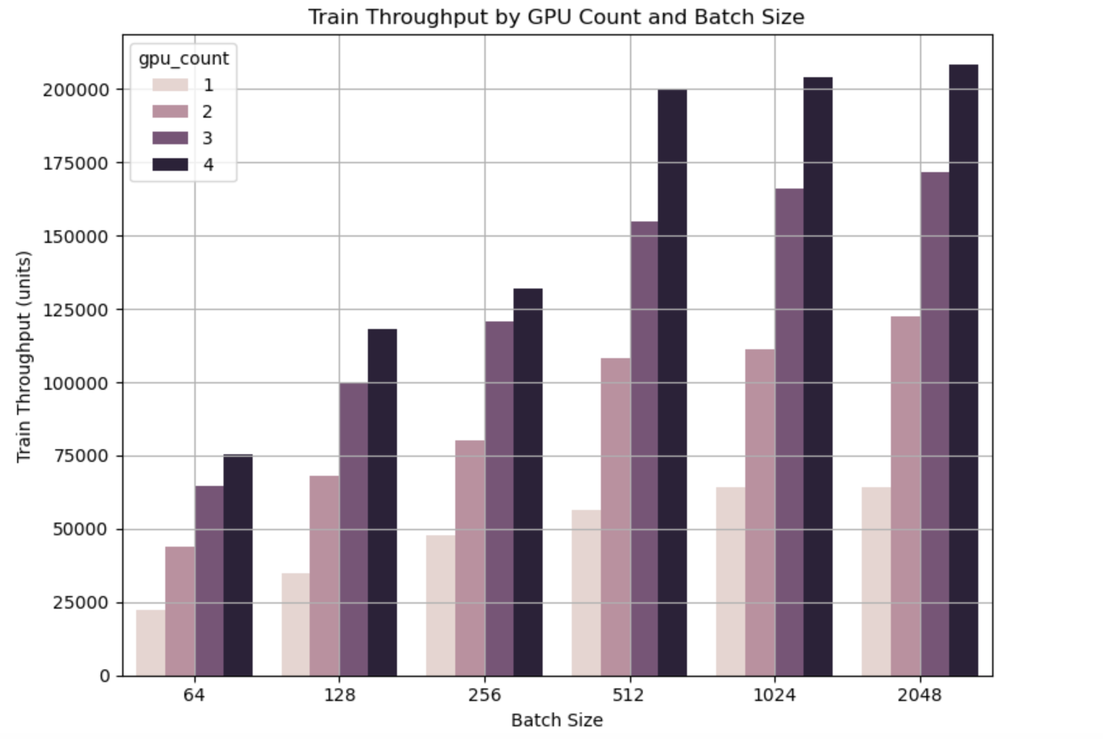
AMP Training Throughput (DDP + AMP(bfloat16))
Notes:
GPU Scaling Effects:
Throughput scales impressively with GPU count for all batch sizes
For batch size 64: Throughput increases from ~22K to ~75K samples/sec (3.4× improvement)
For batch size 2048: Throughput jumps from ~64K to ~208K samples/sec (3.25× improvement)

Slide 25
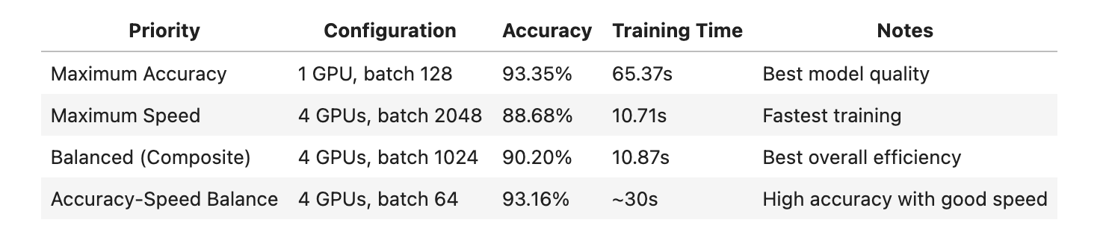
The Optimal Training Configuration (DDP + AMP(bfloat16))
GPU Count: 1, Batch Size: 128
Best Epoch: 12
Accuracy Metrics:
Train Accuracy: 95.54%
Validation Accuracy: 93.49%
Test Accuracy: 93.35%
Loss Metrics:
Train Loss: 0.1253
Validation Loss: 0.2265
Best Configuration Based on Highest Test Accuracy and Lowest Total Training Time
GPU Count: 4, Batch Size: 1024
Training Time: 10.87 seconds
Test Accuracy: 90.20%

Slide 26
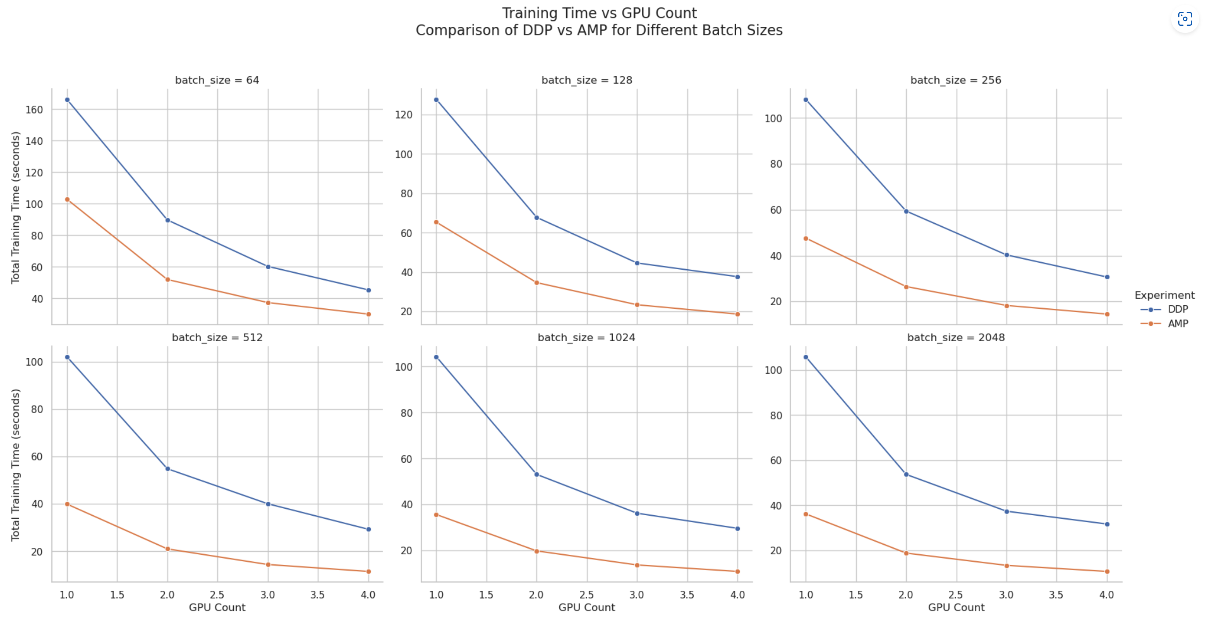
DDP vs AMP Training times Across GPU and Batch Size Configurations
Notes:
Consistent Performance Gap: AMP provides substantial speedups across all configurations
Parallel Scaling Patterns: Both techniques show similar scaling behavior as GPU count increases, but AMP maintains its advantage throughout which leads to lesser training time compared to ddp with fp32

Slide 27
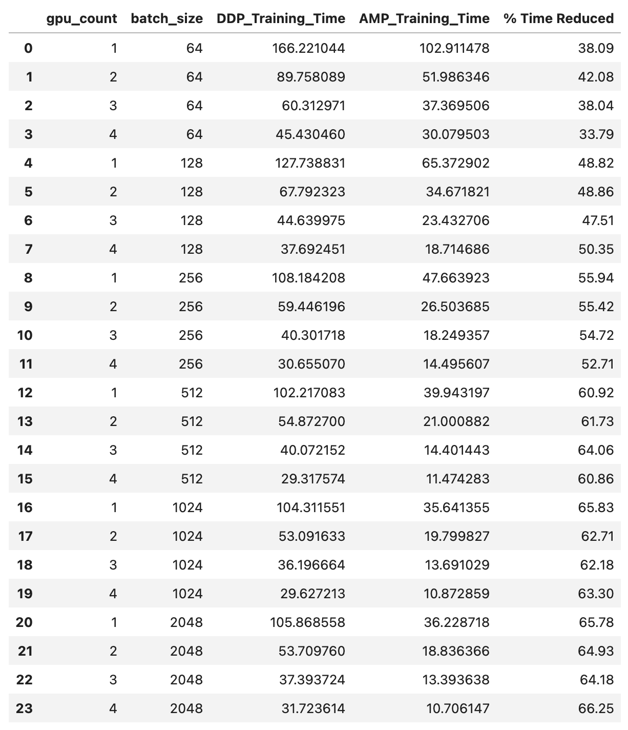
DDP vs AMP Training Performance
Training Time Reduction with Mixed Precision
Universal Speedup: AMP consistently delivers significant training time reductions across all GPU counts and batch sizes
Scaling with Batch Size: Time reduction generally increases with larger batch sizes
Batch size 64: ~38-42% reduction
Batch size 2048: ~64-66% reduction
Most Dramatic Improvements:
4 GPUs, batch size 2048: 66.25% reduction (31.72s → 10.71s)
1 GPU, batch size 1024: 65.83% reduction (104.31s → 35.64s)
Consistent Benefits: Even the smallest improvement (4 GPUs, batch size 64) still shows a substantial 33.79% reduction
Notes:
Training Time Reduction with Mixed Precision
Universal Speedup: AMP consistently delivers significant training time reductions across all GPU counts and batch sizes
Scaling with Batch Size: Time reduction generally increases with larger batch sizes
Batch size 64: ~38-42% reduction
Batch size 2048: ~64-66% reduction
Most Dramatic Improvements:
4 GPUs, batch size 2048: 66.25% reduction
1 GPU, batch size 1024: 65.83% reduction

Slide 28
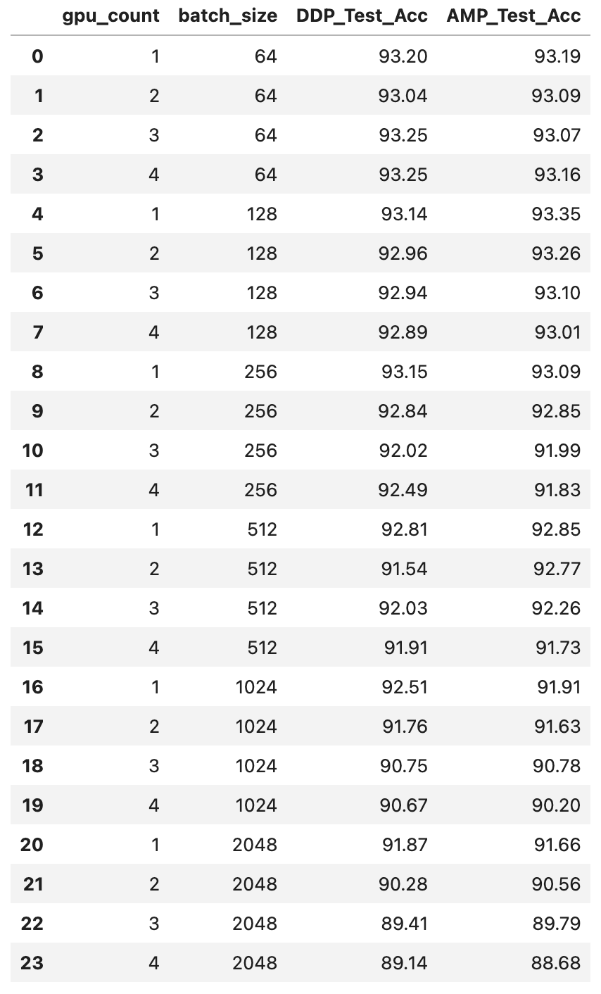
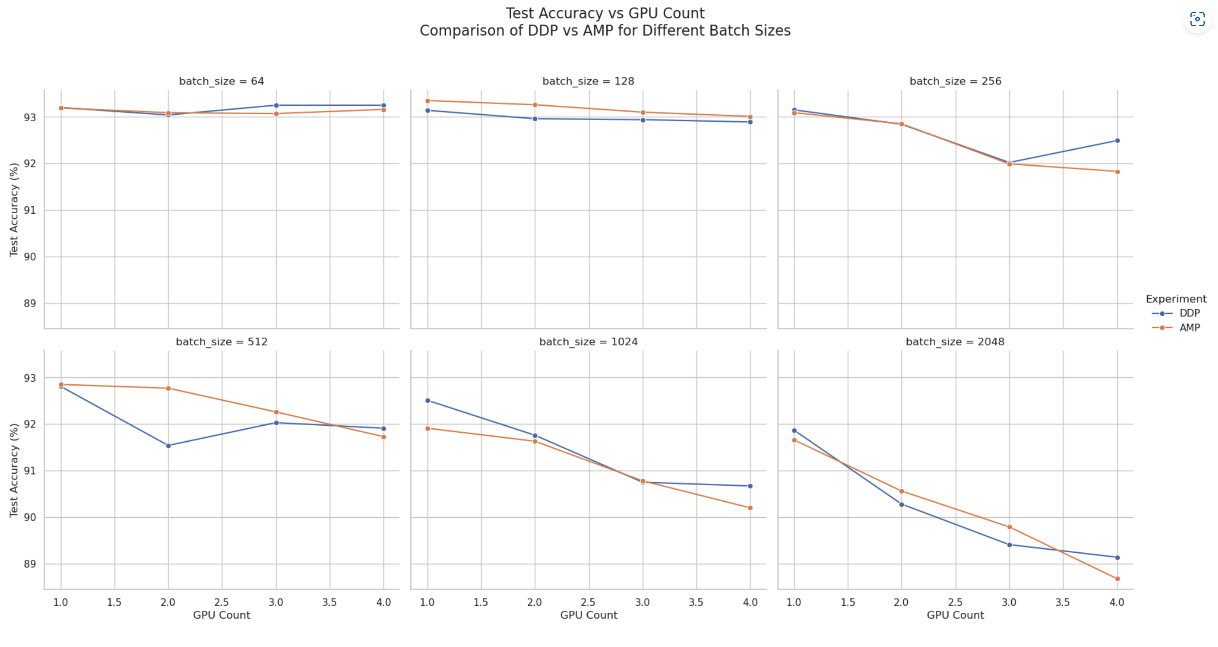
Test Accuracy Comparison: DDP vs AMP
Notes:
Small Batch Sizes (64-128):
Both methods achieve excellent accuracy (>93%)
Medium Batch Sizes (256-512):
Both methods maintain good accuracy (>91.5% for most configurations)
Slight accuracy variations between methods, but differences are minimal
Large Batch Sizes (1024-2048):
Both methods show progressive accuracy decline
Accuracy drops below 90% for configurations with 3-4 GPUs

Slide 29
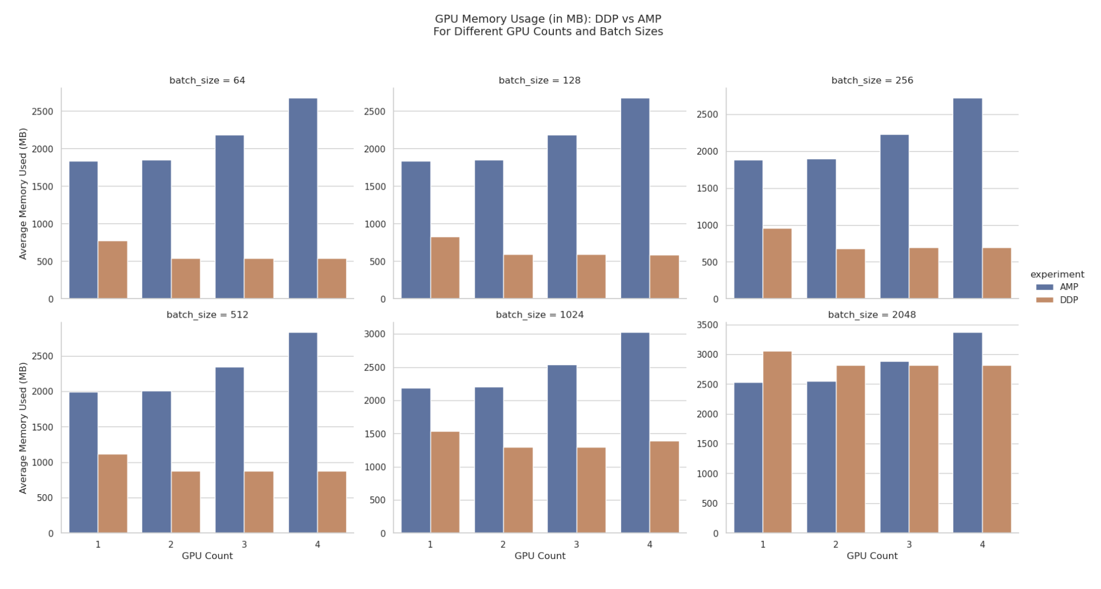
Memory Usage Comparison Between DDP and AMP
Notes:
Overall Memory Usage:
Surprisingly, AMP consistently uses more memory per GPU than DDP across almost all configurations
Scaling with Batch Size:
Both methods show expected increases in memory usage with larger batch sizes
By looking at the plots we can see that memory allocation is similar for the batch sizes until 512 then increases thereby with increase in batch size.
We can also observe that with batch size 1024 and more there is a drastic increase in memory usage for DDP compared to mixed precision.
So we can conclude that mixed precision training utilizes less memory with increase in batch size

Slide 30
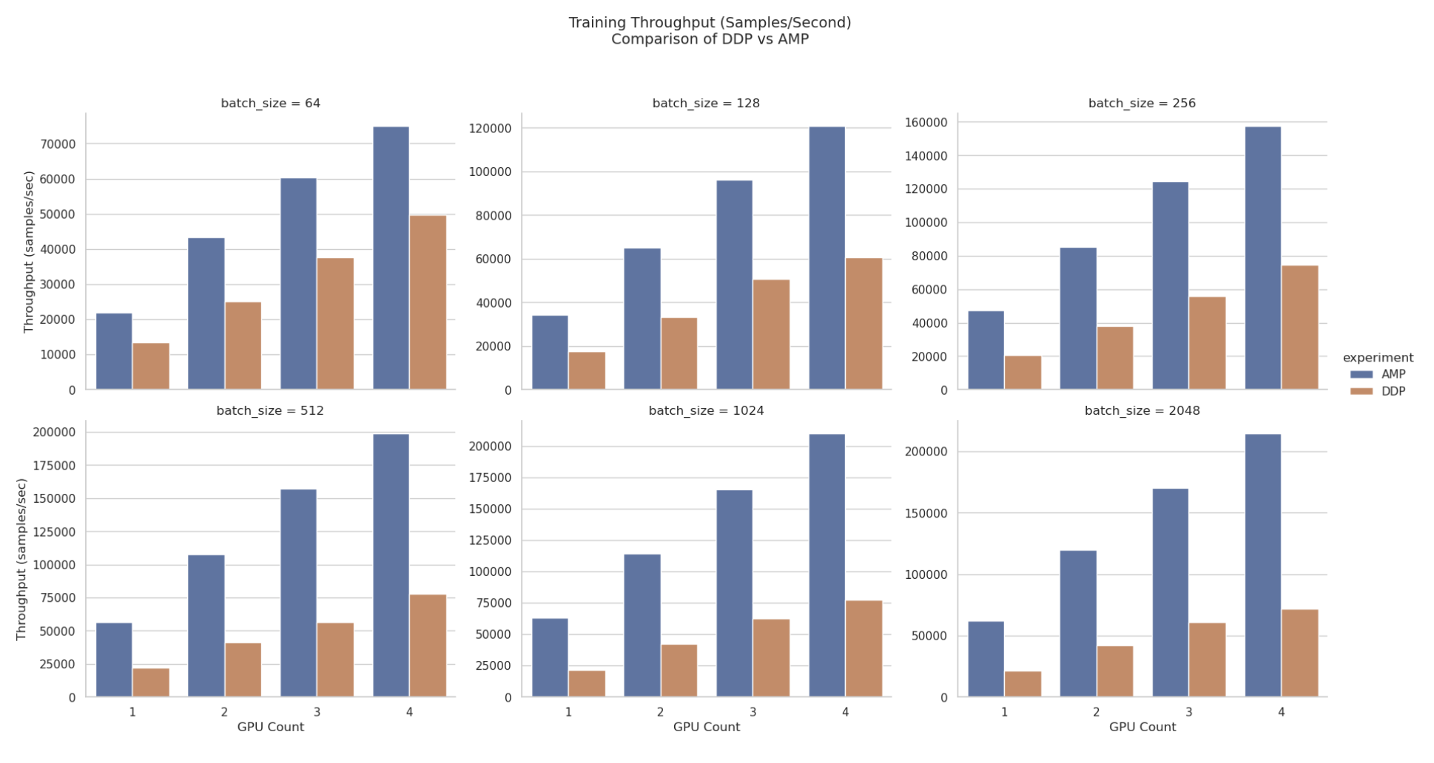
Training Throughput: DDP vs AMP¶
Notes:
Consistent Performance Advantage:
AMP dramatically outperforms DDP across all configurations
With 1 GPU and batch size 64: AMP processes 21,885 samples/sec vs DDP's 13,529 samples/sec (62% improvement)
Scaling Characteristics:
Both methods show good scaling with additional GPUs, but AMP scales more efficiently
At batch size 512: AMP throughput reaches 198,720 samples/sec with 4 GPUs (3.5× the throughput of 1 GPU)
The highest throughput achieved is 214,423 samples/sec (AMP, 4 GPUs, batch size 2048)
Exponential Improvements:
The percentage advantage of AMP over DDP increases with configuration complexity:
Small configurations (1-2 GPUs, batch sizes 64-128): 60-95% improvement
Medium configurations (2-3 GPUs, batch sizes 256-512): 120-180% improvement
Large configurations (3-4 GPUs, batch sizes 1024-2048): 160-199% improvement

Slide 31
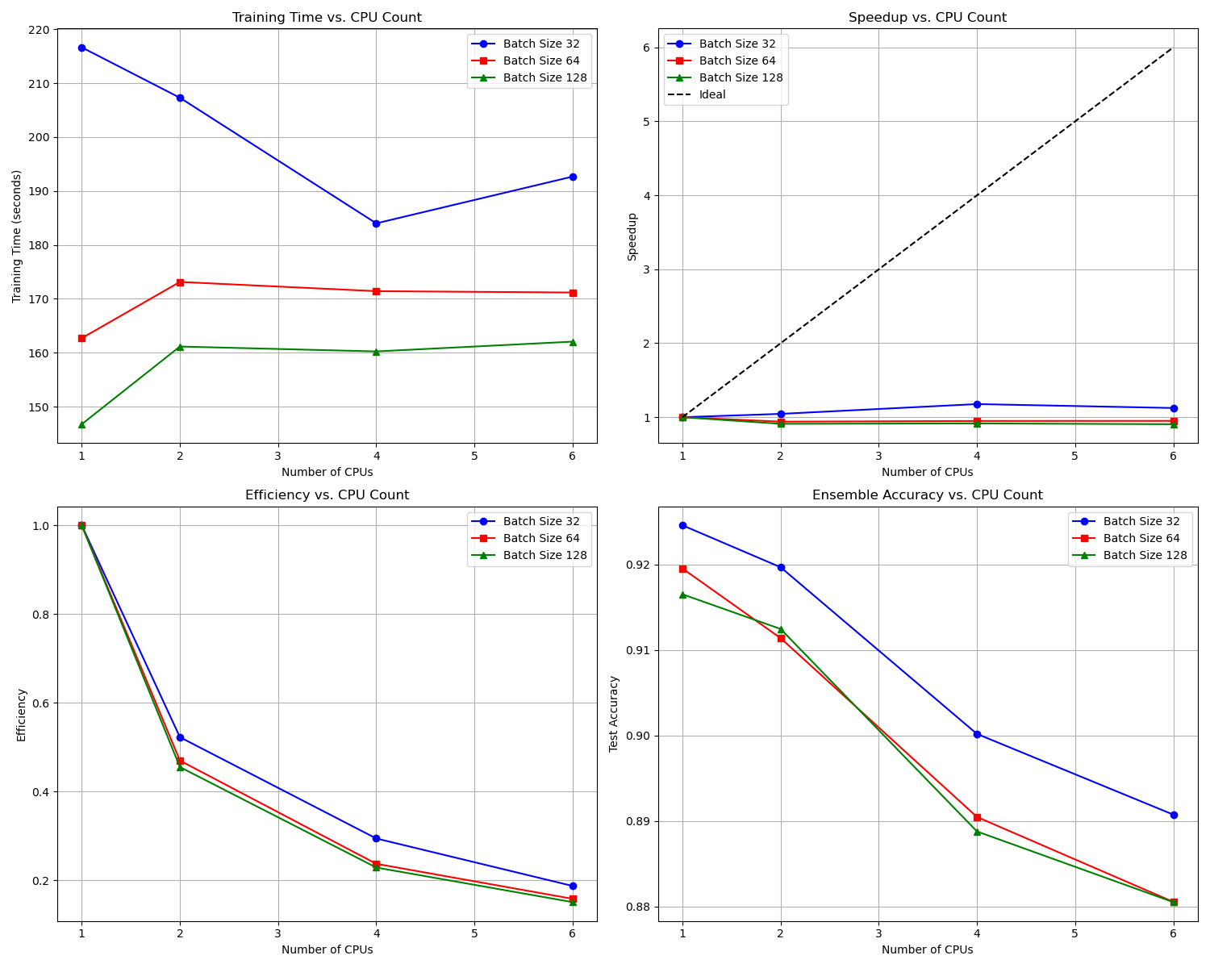
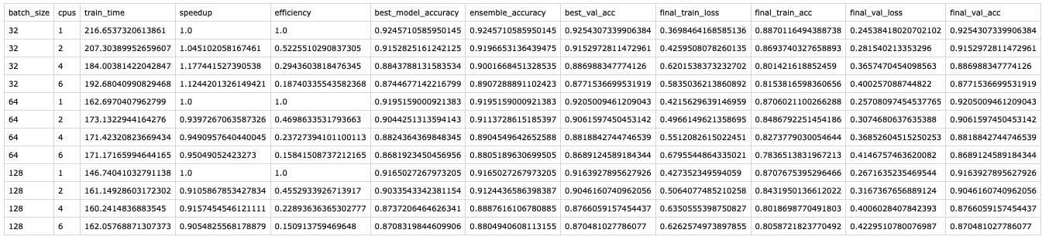
Joblib on Multi-CPUs (Speed Up, Efficiency and Accuracy)
Notes:
Batch Size Impact and Sub-optimal Scaling and Parallelization Overhead
Maximum Speedup: The best speedup observed was 1.17× with 4 CPUs for batch size 32, far below the theoretical 4× speedup
Optimal Configuration: The 2-CPU ensemble achieved the best balance of accuracy and computational efficiency: Batch size 32: Ensemble accuracy of 91.6% vs. 90.5% best individual model
Batch size 64: Ensemble accuracy of 91.3% vs. 90.5% best individual model
Batch size 128: Ensemble accuracy of 90.7% vs. 90.1% best individual model
Key Findings from Your Joblib CPU Experiments:
For batch size 32:
Best individual model (1 CPU): 92.03%
Ensemble of 2 models (from 2 CPUs): 91.58% (+1.12% over the best individual model from 2 CPUs)
Ensemble of 4 models: 90.15% (+0.69% over the best individual model from 4 CPUs)
Ensemble of 6 models: 88.74% (+0.04% over the best individual model from 6 CPUs)
For batch size 64:
Best individual model (1 CPU): 91.51%
Ensemble of 2 models: 91.28% (+0.76% over the best individual model from 2 CPUs)
Ensemble of 4 models: 89.57% (+0.73% over the best individual model from 4 CPUs)
Ensemble of 6 models: 88.29% (+0.01% over the best individual model from 6 CPUs)
For batch size 128:
Best individual model (1 CPU): 91.44%
Ensemble of 2 models: 90.73% (+0.63% over the best individual model from 2 CPUs)
Ensemble of 4 models: 89.03% (+1.10% over the best individual model from 4 CPUs)
Ensemble of 6 models: 87.75% (+1.17% over the best individual model from 6 CPUs)

Slide 32
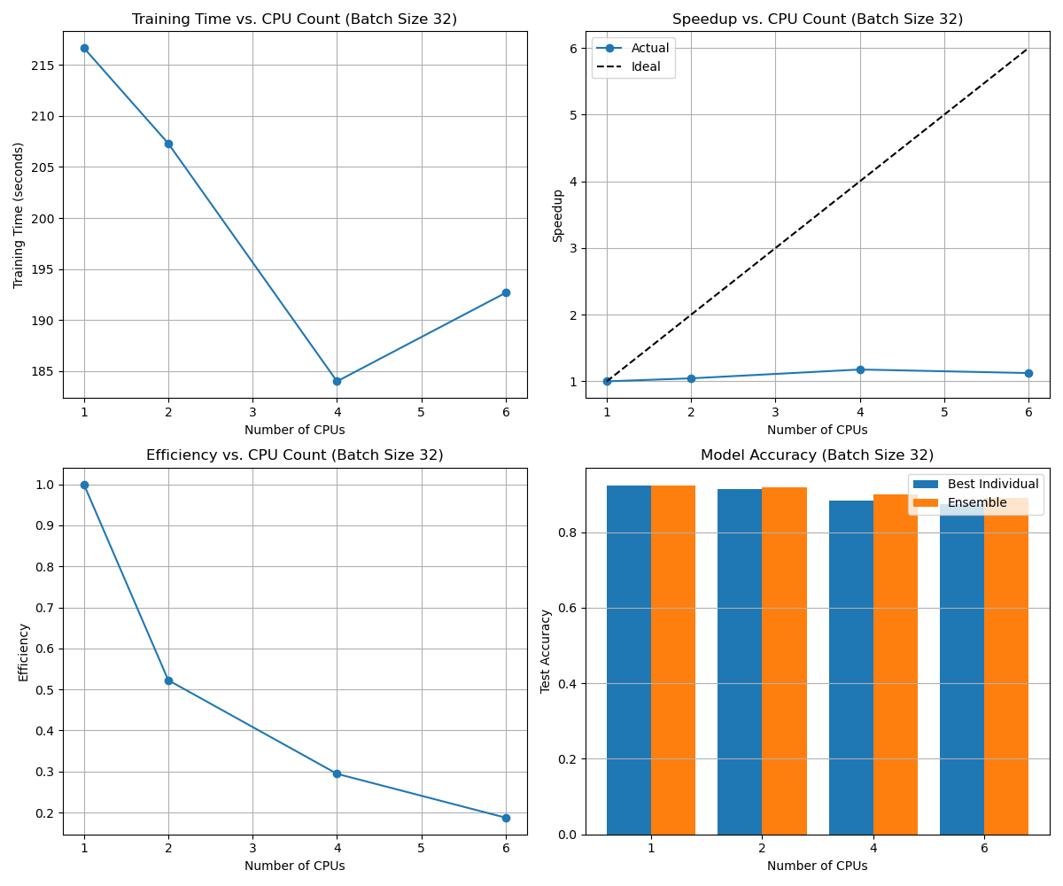
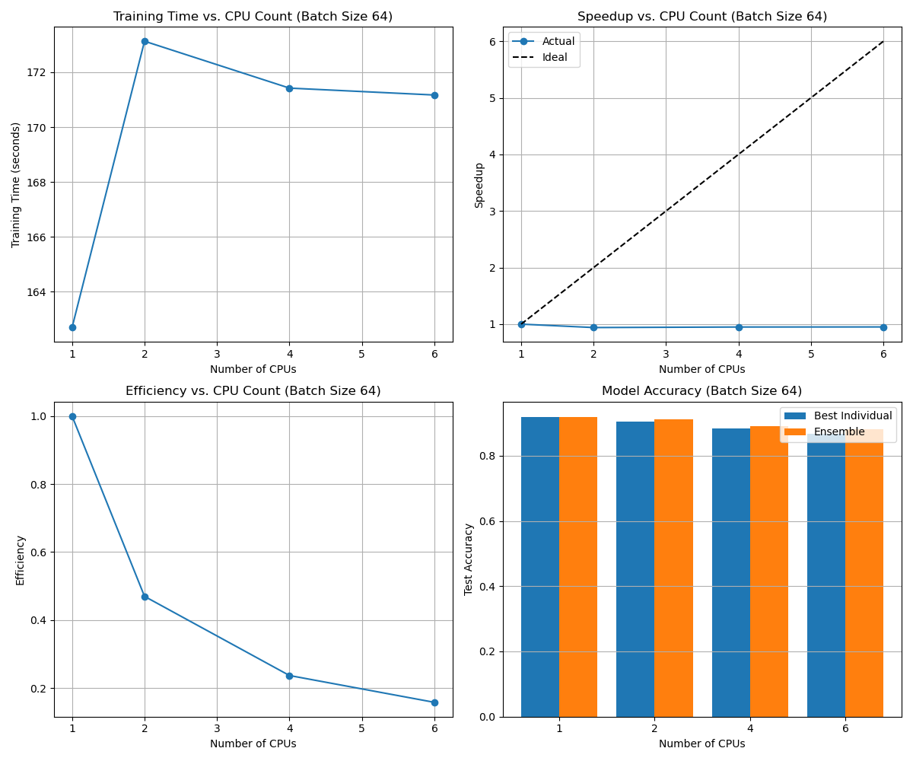
Multi-CPUs using Joblib (different batch sizes)
Notes:
Batch Size Impact and Sub-optimal Scaling and Parallelization Overhead
Maximum Speedup: The best speedup observed was 1.17× with 4 CPUs for batch size 32, far below the theoretical 4× speedup
Optimal Configuration: The 2-CPU ensemble achieved the best balance of accuracy and computational efficiency: Batch size 32: Ensemble accuracy of 91.6% vs. 90.5% best individual model
Batch size 64: Ensemble accuracy of 91.3% vs. 90.5% best individual model
Batch size 128: Ensemble accuracy of 90.7% vs. 90.1% best individual model
Key Findings from Your Joblib CPU Experiments:
For batch size 32:
Best individual model (1 CPU): 92.03%
Ensemble of 2 models (from 2 CPUs): 91.58% (+1.12% over the best individual model from 2 CPUs)
Ensemble of 4 models: 90.15% (+0.69% over the best individual model from 4 CPUs)
Ensemble of 6 models: 88.74% (+0.04% over the best individual model from 6 CPUs)
For batch size 64:
Best individual model (1 CPU): 91.51%
Ensemble of 2 models: 91.28% (+0.76% over the best individual model from 2 CPUs)
Ensemble of 4 models: 89.57% (+0.73% over the best individual model from 4 CPUs)
Ensemble of 6 models: 88.29% (+0.01% over the best individual model from 6 CPUs)
For batch size 128:
Best individual model (1 CPU): 91.44%
Ensemble of 2 models: 90.73% (+0.63% over the best individual model from 2 CPUs)
Ensemble of 4 models: 89.03% (+1.10% over the best individual model from 4 CPUs)
Ensemble of 6 models: 87.75% (+1.17% over the best individual model from 6 CPUs)

Slide 33






DDP on Multi-CPUs (learnings from failure)
Notes:
CPU Count. Test Accuracy Relative to Baseline
1 91.16% 0.00% (baseline)
2 89.47% -1.69%
4 86.84% -4.32% 6 86.88% -4.28%
CPU Count Training Time (seconds) Relative to Baseline
1 138.99 1.00× (baseline) 2 327.58 0.42× (2.36× slower)
4 428.01 0.32× (3.08× slower)
6 432.60 0.32× (3.11× slower)
Communication Overhead Dominance
Reduced Per-Process Batch Size

Slide 34
Thank You

